Slide 1
1,2,3 Present!
Mastering and Teaching Presentation Skills
Dr. Judy Henn
The Technion

Slide 2


Learning and Teaching
Communication is the key
Personal and professional goals
Adding a new set of skills

Slide 3


Learn, then teach…
or, learn by teaching…
Start at the beginning:
Find a topic

Slide 4


Generating Topics & Outlining
Brainstorming – individually or in a group
Major points – according to time limit

Slide 5
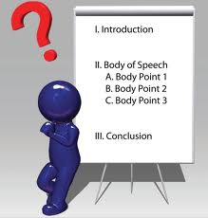
Types of outlines:
Introduction→ Body→
Conclusion

Slide 6
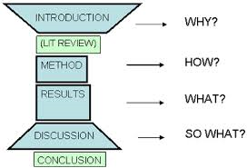
2. I-M-R-D

Slide 7

How to design PPT slides
Rule of 6 X 6 or 7 X 7
Font size: at least 24
Ariel – 48
Ariel - 40
Ariel – 32
Ariel – 24
Ariel – 18

Slide 8

Light background, dark letters
Recommended fonts: Tahoma, Ariel, Verdana
Beware of fancy fonts, lack of contrast, unreadable italics

Slide 9

Do not use more than 2 fonts per presentation
Remember: all bulleted lists must be parallel

Slide 10

Capitals and Italics
DO NOT USE ALL CAPITAL LETTERS
  Makes text hard to read
  Denies their use for EMPHASIS
Italics
  Save for “quotes”
  Use to highlight thoughts or ideas
  Use for book or journal titles

Slide 11

The Presentation Itself
Keep your eyes mainly on your audience
Turn to your slides BRIEFLY only to gesture at your text or graphic

Slide 12


Pay Attention to Each Slide
Tell your audience what they will see, using synonyms.
Do Not Read the slides to the audience.

Slide 13


Give the audience time to absorb, then comment by paraphrasing the text.
Limit yourself to one to two slides per minute.

Slide 14

Slide Design
Clarity is the key

Slide 15

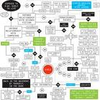
Charts and Diagrams
Simplify complicated diagrams

Slide 16
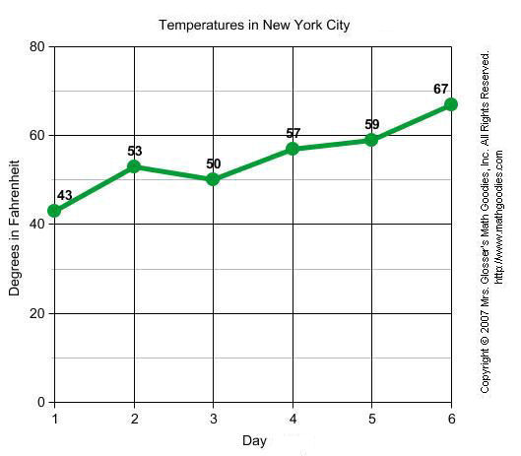
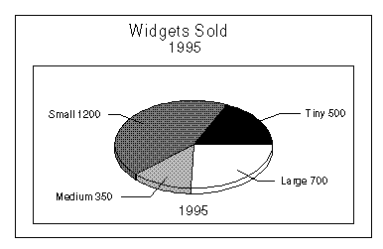
Learn to identify and describe 6 types of graphs and charts:
Line graph: points connected by lines show changes in value
Pie chart: units of data represented as pie-shaped pieces of a circle

Slide 17
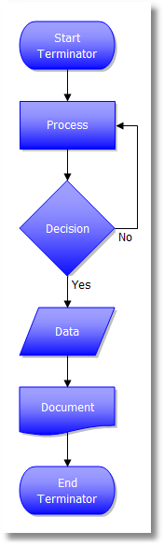
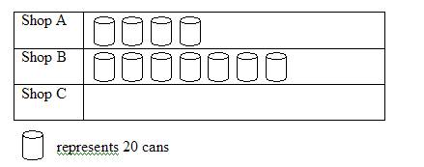
Flow chart: symbolic representation of process - each step represented by a different symbol linked with arrows showing flow direction
Pictogram: statistics in
pictorial form

Slide 18
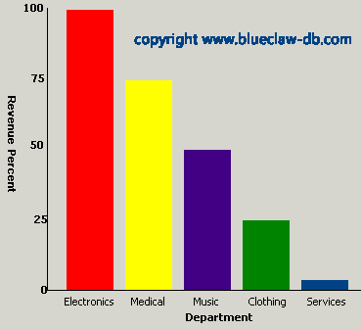
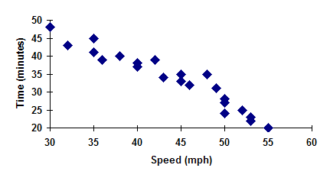
Bar chart: bars whose lengths are proportional to quantities
Scatter diagram: unconnected points of data

Slide 19
Useful Descriptive Verbs
Increase, soar, rocket, rise
Decrease, plummet, drop, decline, fall
Peak, level out, fluctuate

Slide 20
Useful Adverbs & Adjectives
Significantly / insignificantly
Steadily, slowly, dramatically, sharply
Moderately, slightly

Slide 21
EXAMPLES:
Downloads increased dramatically.
There was a moderate drop in sales.

Slide 22
Amount of Information
Voice Control and Eye Contact
Effective use of the voice, eye contact, posture, gestures, and enthusiasm distinguish a routine presentation from a memorable one.
The characteristics of delivery in terms of voice control can be separated into several interrelated properties: sound, volume, speed, and rhythm.
Articulation and eye contact are the two most important components of voice presentation. Take the time to articulate every work of each sentence clearly, while maintaining eye contact with your audience.
As with written text, the end of the sentence designates the "stress" position. It is here the audience expects to be provided with the most important information.
Nervous, hurried speech often leads to inaccurate articulation. Take your time and do not speak faster than your normal conversational speed.
Monotony is the greatest enemy of a scientific presentation.
Plain silence is preferable to mere noise.
Slowing down is a remedy for 90 percent of most speakers' problems.
Looking straight at members of the audience establishes the notion that you are talking to them, not just in front of them.
Foreign speakers who have severe language problems giving a scientific presentation should:
Rehearse and practice the presentation often, preferably with a friend who is a native English speaker, and almost learn it by heart.

Slide 23
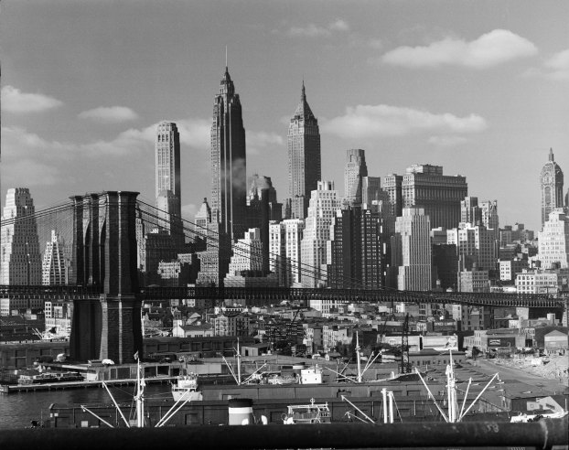

How to Choose Illustrations
Why do you want/need illustrations?
Photo or clip art?
Which is more effective?
What suits your topic?

Slide 24

Graphics Must Enhance
Check that your
text is legible
illustrations are clear
ideas stand out

Slide 25

Overcoming Stage Fright
Develop visualization skills
Replace negative thought patterns with positive ones:
It will be a disaster → I will aim to do the best I can

Slide 26
Limit Your Fears
At 9 o’clock, I’ll stop
worrying about
my presentation.
I’ll take my mind off
the presentation
by doing something else.

Slide 27
Practice
In front of a mirror
In front of an audience
In your head
Time yourself

Slide 28
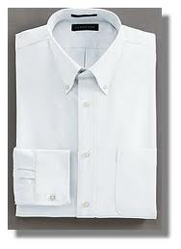
At Home
Make a check-list and see that everything is ready (laptop, USB)
Plan your wardrobe and check that everything is clean and ironed
3. Sleep well the night before

Slide 29


The Venue
Arrive early
Check the equipment
Upload your presentation
Note where the necessary gadgets are
Have water ready (cup, bottle)

Slide 30

1 Minute to Curtain
Sip some water
Concentrate on success
Breathe

Slide 31
In the Beginning…
Start slowly and speak clearly (especially if you have an accent)
Do NOT mention if you’re nervous
Concentrate on staying calm the first 5 minutes (and by then you’ll be okay)

Slide 32

The Audience
Look at the people and SMILE
Focus on making your best performance
Enjoy yourself

Slide 33

Remember!
It’s NOT about YOU – it’s about your TOPIC and your desire to talk
about it and
share it

Slide 34

PRACTICE
BUILDS
CONFIDENCE

Slide 35

Eye Contact
Express emotion with your eyes.
Ensure eye contact as you deliver all critical lines.
Sustain eye contact for a few seconds, then move on.

Slide 36

Posture & Gestures
Appear confident: stand tall
Control your gestures
Use gestures that move away from your body

Slide 37



Volume, Pace and Pitch
Vary all for emphasis.

Slide 38

Answering Questions
Limit the question topics: "Have you any questions on the four principles that I've outlined?"
Anticipate and be prepared with answers.
Listen and determine the intention.

Slide 39

Use the Q & A session to reinforce your message.
Paraphrase the question back to the questioner: “You want me to explain the process of ….?

Slide 40


Handle a difficult question by offering to expand afterwards.
If the question is irrelevant, say so.

Slide 41
If you don’t know – say so, or refer the person to resources.
Do NOT:
          Go off the topic
          Make a mini-presentation
          Pass the buck
          Answer defensively

Slide 42
Be a Boy/Girl Scout
Be prepared,
and…

Slide 43
1,
2,
3 –
PRESENT!

Slide 44
References:
http://www.ellenfinkelstein.com/pptblog/create-clear-iconic-illustrations-in-powerpoint-with-gasp-clip-art/
http://www.speakingaboutpresenting.com/presentation-books/overcame-his-stage-fright/
http://wolfgangriebe.wordpress.com/tag/35-tips-on-overcoming-stage-fright/
Overcoming Stage Fright by Emily Lewis
http://libweb.surrey.ac.uk/library/skills/Presentation%20Skills%20Leicester/index.php

