Slide 1
Back to School
Aviva Hazor
Coordinator Ulpanit Tveria
Etai, August 2015

Slide 2
In the next 45 minutes we will-
Get to know “beginning of year” activities for new classes and classes that are not new.
Learn how to do a “Scavenger Hunt” in the new premises.
Discuss organization skills for the teacher and the students.

Slide 3
First lesson of the year:
Activate students – speak, read, write.
Personalize – get to know your students, get them to know one another, get them to know you.
Class rules.

Slide 4
Ice Breakers – new classes
1) Find someone who…/
Get to know you Bingo
2) Name game.
3) Exchanging Places Game.
4) Introduce yourself.
5) Go on a date.
6) About me.
7) Birthday chart.
8) Letters to students from students

Slide 5
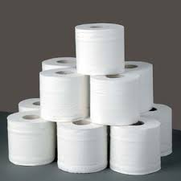
Classes where students know each other / the teacher
1) First quiz of the year.
2) Toilet paper game.
3) Onion
4) Summer events – cuttings from newspapers

Slide 6
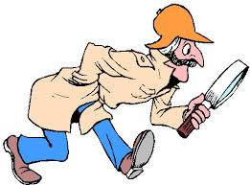
Second lesson
Treasure Hunt – new students in new school.

Slide 7
Organization
1. Make sure you have a list of names before first lesson.
2. Students fill in “Class Information Chart”. Paste into your diary.
3.Ask students to send an e-mail, introducing themselves. Make a class e-mail list. Share the list with the pupils.

Slide 8
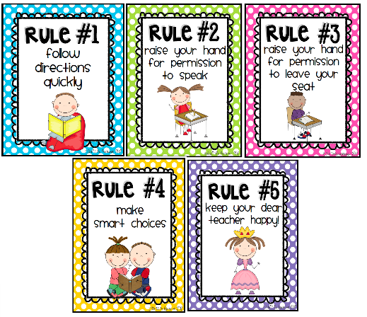
Letter to the Student – class rules - curriculum
First or second lesson.
Make it clear and comprehensive.
Make sure students understand everything (will save time and aggravation later on).

Slide 9
Thank you for listening.
Have a great year.
Aviva Hazor
Aviva_h@ulpanit.ort.org.il
050-3773382

