Slide 1
Turn, Turn, Turn Vocabulary & Grammar

Slide 2
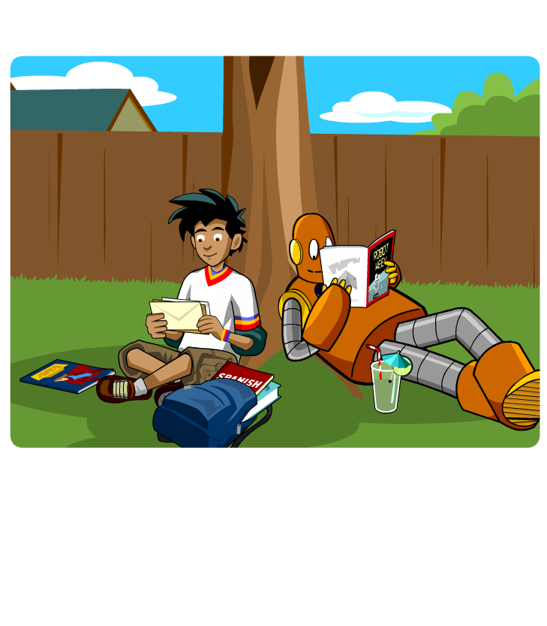
Revised (New) Curriculum
Pre-Foundation Level
Vocabulary & Grammar Lists
Required HOTS
Technological Skills
Literature

Slide 3
Principles in Language Learning
Interaction
Diversity
Interest & Motivation
Scaffolding
Success-oriented Tasks
Authenticity
Independent Learners

Slide 4
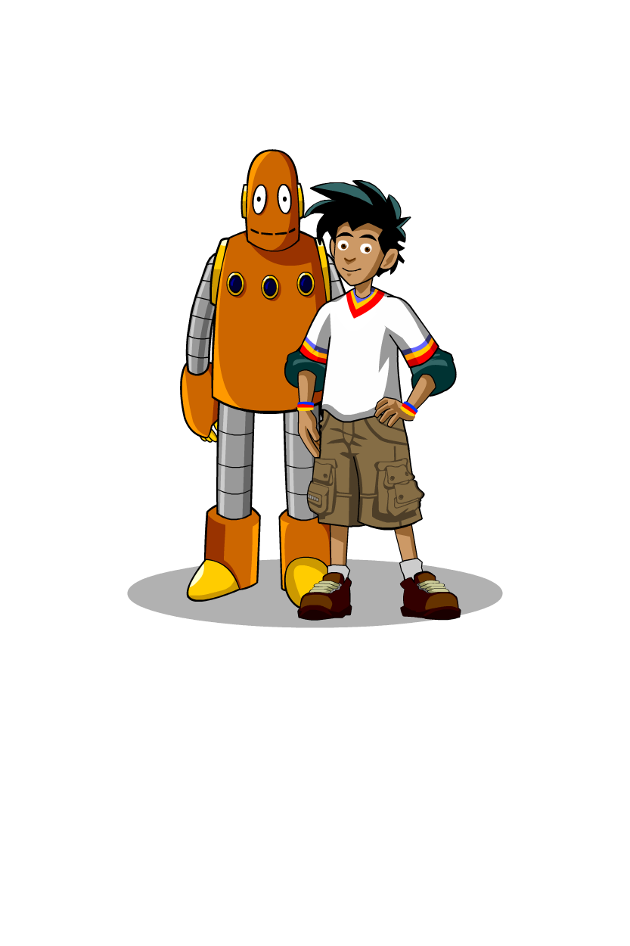
BrainPOP ESL
The Turn-Turn-Turn approach:
Turn to lexis and content.
Turn to focus on learning skills (HOTS).
Turn to grammar.

Slide 5
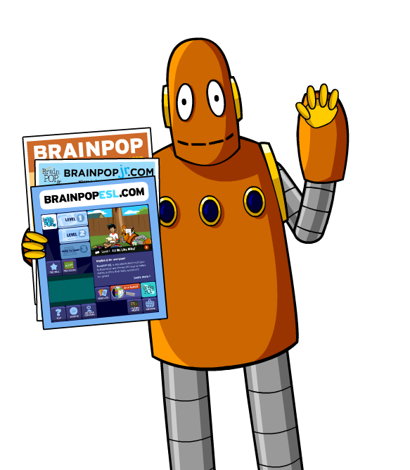
To sum up:
The revised curriculum as a reminder of the receptive /productive element of language learning.
Turn-Turn-Turn in BrainPOP ESL program – first lexis and content then HOTS and then grammar.
Try BrainPOP ESL’s academic yet
friendly and unthreatening
environment alongside your textbook.
Using today’s technology, teach and
learn while doing, the Renaissance way.

