Slide 1
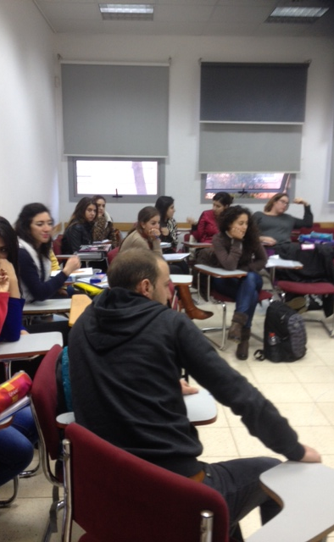
Literary Learning for Enhanced Cross-Cultural Understanding
Michelle Kinsbursky
Ohalo College, Katzrin
ETAI International Conference 2016

Slide 2
I noted that...
Higher Ed is one of the few places where all/most of the cultures meet
An opportunity to get to know other cultures – break down stereotypes
YET...at least at my college, I don’t see much crossing over...

Slide 3
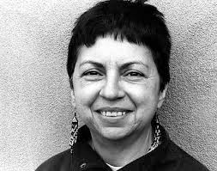
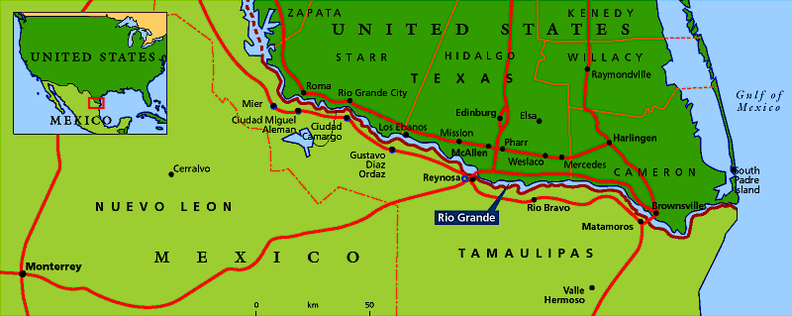
Gloria E. Anzaldúa & Borderlands
Hang in there with me – eventually I will bring us back to Literary study!
Chicanos
Borderlands La Frontera

Slide 4
A border is what divides two peoples, lands, etc
But the borderland is all that area at the border....NOT one side of the border or the other.
Binary opposites: white vs black, male vs female, native vs non-native
Creates a hierarchy: where one is considered better than the other.

Slide 5
“[T]he Borderlands are physically present wherever two or more cultures edge each other,
where people of different races occupy the same territory. . . where the spaces between two individual shrinks with intimacy. “
Borderlands ~ La Frontera
The New Mestiza (1987)

Slide 6
Anzaldúa moves away from a binary – oppositional way of thinking ...to...the individual as a blend/mix/hybrid - The Borderlands
All people have this in common
And we are all part of the human race
She’s not saying... we should all be one culture : the KEY – not one in particular is better

Slide 7
Her thinking came out in 80s
Questioning Anglo-colonialism
Groups – demanding rightful place
Exclusiveness
Anzaldúa – Inclusiveness
Think about what we share
NOT what separates us!

Slide 8
NOW getting back to Literature...
Teaching in Israel – specifically teaching a diverse population
MAYBE...
Literature study + Anzaldua’s thinking about living in the borderland could lead to greater cross cultural understanding

Slide 9
How?...Literature...
Encourages dialogue – reflection, discussion
It’s a space to share and to listen in to others
I teach: Intro to Literature English Curriculum’s Standard
Appreciation of Language, Lit,
and Culture

Slide 10
Supported by the Higher Council of Education (policy paper)
“Every teacher training curriculum
will reflect the following central core elements . . . Instruction in learning
about pupils with different needs and
from different social-cultural groups” (2008)

Slide 11
Not only does our literature study have the potential to bring students into a discussion – to cross some of those borders
The course is taught in English
English is a Neutral Language of Study
Can remove specific language - bias

Slide 12
Do not teach Anzaldua directly
Borderlands thinking – subtheme
Engaged students in:
Discussions
Letter & Forum writing
Class activities
LET’s Take a look
at some Examples

Slide 13
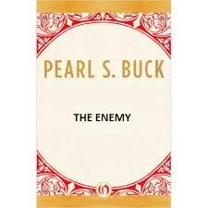
“The Enemy” Pearl S. Buck
Brief review
Discussions of loyalty and professional responsibilities
Introduce Borderlands subtheme – when discussing Sadao’s dilemma
Classroom activity followed by letter writing

Slide 14
Here are some students’ comments...
Dear Sadao . . .
I think your final decision to save the life of Tom was the right and the brave decision. I’m not sure it was your enemy, after all the war is a matter of politics and the people who fight the war are ordinary people like you and me, with a family and children and they deserve to live.
Marchella

Slide 15
Dear Dr. Sadao,
It’s obvious that you’re a borderland person, just like me, Dr. Sadao. I do understand your hard situation, because I am from Syria in origin and I live in Israel physically. I know how it feels to live in a borderland but believe me if any person in Israel asks for my help, for sure I will help him without any doubt because in the end we are all human beings we should help each other no matter if we came from different places, religions, nation, race. Maya

Slide 16
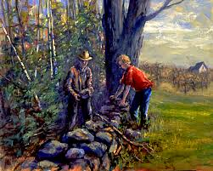
“Mending Wall” Robert Frost
“Good fences make
good neighbors”?
Should people define themselves as being on one side of the border or the other?
Activity

Slide 17
Kanar:
I think that there are so many kinds of walls that people put between each other, one of them is borders and I think the cause of all borders that people put between themselves and others is because of fear, if we don't fear something there is absolutely no reason to put a border between ourselves and others.

Slide 18
Irena responds to Kanar with this letter:
I agree with you, I also think that many times people put borders between them because they [are] afraid and they try to protect themselves from people that they don't know. I think that borders are an emotional and physical protection and everyone needs [them]. . . So I think it is necessary to have walls.

Slide 19
Or decides to sit on the wall, she may be pointing to the complexity of living in the borderlands:
When we learned the poem "Mending wall" by Robert Frost, you divided the class with a line of chairs down the middle and asked the class to stand on either side,. . . I personally sat on one of the chairs in the middle, because I think it depends on the situation, the circumstances and on what exactly we mean when we say "wall".

Slide 20
What do these examples point towards?
Diverse cultures discussing the conflicts we have about the borders that exist
Also students hear a range of the thoughts and opinions on very complex issues
Sometimes feeling similar to someone from a different culture

Slide 21
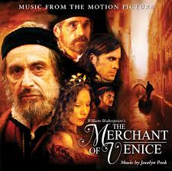
Shakespeare’s The Merchant of Venice
Don’t have time for full literary study
Expose them to Dramatic text
Experience Shakespeare and see can be accessible
Introduce them to performance studies – to comprehend literary works

Slide 22
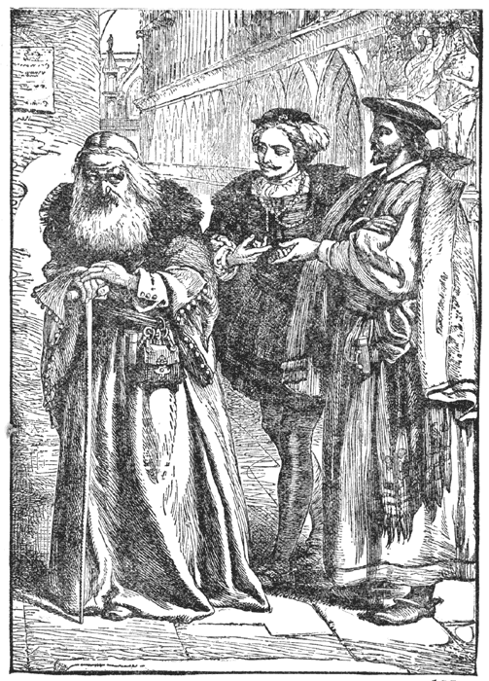
Act 3/ Scene 1-Activity
He hath disgraced me, . . . Scorned
my nation . . . and what's his reason?
I am a Jew. Hath not a Jew eyes? Hath not a Jew hands, organs, dimensions, senses, affections, passions? -fed with the same food, hurt with the same weapons, subject to the same diseases, healed by the same means, warmed and cooled by the same winter and summer. . . If you tickle us, do we not laugh? If you poison us, do we not die?

Slide 23
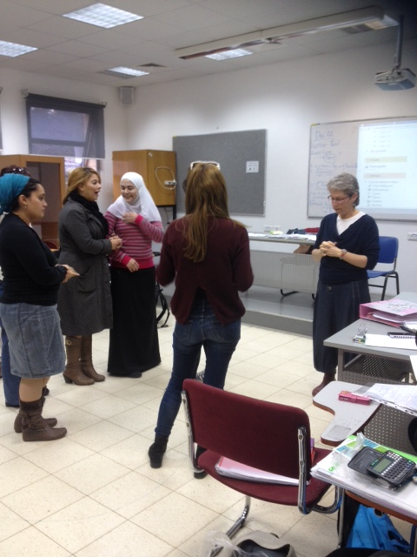
Hanan: I do not like drama, but surprisingly I liked Shakespeare's The Merchant of Venice only because Shylock's beautiful monologue.
Miryam: the inspiring monologue in the “Merchant of Venice”, which I’m sure to teach in my future class . . . represents the idea of being humanistic, and I believe it is a powerful and important message which I would like my students to assimilate.

Slide 24
Sharing their ideas
Speaking openly
Different cultures in dialogue
In Closing, note what students say overall...

Slide 25
Kanar:
Doing the interesting activity together made us closer to each other. At the beginning of the year we almost didn’t know each other, but during the first semester we started to approach each other, and during the second semester we started to enjoy working with each other . . . at the end of the semester especially when we started the performance section we really got to know each other.

Slide 26
Karin:
Our study of literature and borderland thinking led me to see that there are many people around me which have the same abilities and qualities like I have, led me to develop conversations with people I never thought I will have something in common with. I found out there are many students which I never thought I would speak to, laugh and do projects with and it caught me by surprise but now I have more friends than I thought I would. People are complex creatures and have many layers and we only have to take those layers down and get to know each other.

Slide 27
Naturally not all like this
Hope...carry these experiences into their future classrooms
Most classes are homogenous, but...
What I’ve tried to do in my teaching of literature is summed up by Anzaldúa...

Slide 28
“Educators need to create fertile ground
for the coming generations ...
How do we create a fertile ground? . . . Teaching and learning are
transformative experiences . . .
requires that we open all our senses,
not just our minds,
and allow ourselves to be changed
by books and perspectives of other people. It requires that we unleash our passion
for social justice.”
Gloria Anazaldúa
“Transforming American Studies”

Slide 29
Thanks for
Listening!
Literary Learning
for Enhanced
Cross-Cultural Understanding

Slide 30
Works Cited
Anzaldúa, Gloria. Borderlands/ La Frontera: The New Mestiza. 4th ed. San Francisco: Aunt Lute Books, 2012. Print.
---. “Transforming American Studies.” 2001 Bode-Pearson Prize acceptance speech. The Gloria Anzaldúa Reader. Keating 239-241.
Israel. Council for Higher Education. Ministry of Education Basic Standards (מתווים מנחים להכשרה להוראה במוסדות להשכלה גבוהה בישראל). Trans. Michelle Kinsbursky. Jerusalem: n.p., 2008. Web. 12 Jul. 2015. PDFfile.

