Slide 1
Making lessons memorable
Marjorie Rosenberg
7th International ETAI Conference
4 – 6 July 2016
Ashkelon, Israel

Slide 2
What makes lessons memorable?
Personalised
Physical
Emotional
Intellectual
Relevant
Fun
Creative
Varied
Sandy Millin
www.eltpics

Slide 3
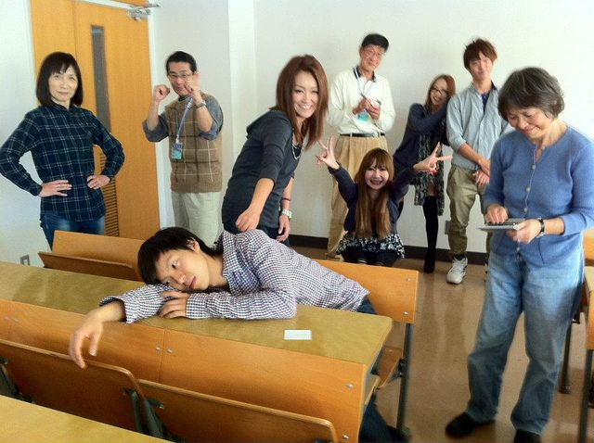
Making lessons personal
Experiences from learners
Material relevant to their lives
Personal interests
Real communication
Opinions from learners
Sharing information with learners
Accept the fact that not all students will offer personal information
Chuck Sandy
www.eltpics
Notes:
Give example of personal dictation (first write down sentences about teacher that they think are true, then their own – could make up statements for others) pic – human vocab experiment

Slide 4
Personalised Activities
Personal dictation
Interviews
Writing stories about others
The first time I …
Personal mind map
Marjorie
BE
1981
IATEFL
New York
Graz
Opera

Slide 5
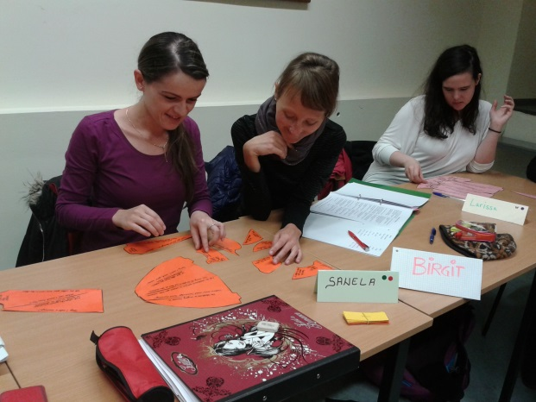
Making lessons Physical
Movement to energise learners
Manipulatives
Role plays
Simulations
Keep in mind that not every learner is comfortable moving about
Students at the
University of Graz
Notes:
I bet you can’t or This is my head

Slide 6
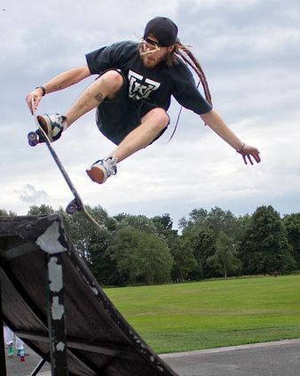
Physical Activities
Board and card games
Jigsaw puzzles
Songs with movement
‘I bet you can’t …’
Martin Eayrs
www.eltpics

Slide 7
Making Lessons Emotional
Vocabulary of emotions related to feelings
Expressing feelings to engage learners
Eliciting emotions through music or art
Categorising emotions
These may be private and not something everyone wants to talk about
VictoriaB52
www.eltpics
Notes:
Emotional dictation – today I feel … because – talk about favorites (food, place, etc) or things that make you feel good – or guess about others

Slide 8
Emotional Activities
‘Today I feel … because …’
‘My favourite memory is …’
‘Guess my favourite food, place …’
‘The best holiday I ever had was … and why …’
@elt_pics
www.eltpics

Slide 9
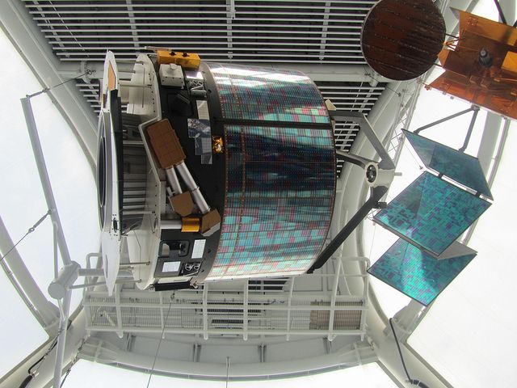
Making Lessons Intellectual
Higher-order thinking skills
Error correction
Field trips to museums: enhance classroom learning
Inductive grammar
Organisation of writing
Some students may want the rules or prefer to be told the correct answer
Sandy Millin
www.eltpics
Notes:
Haikus, correcting errors, finding puns, discovering how you learn

Slide 10
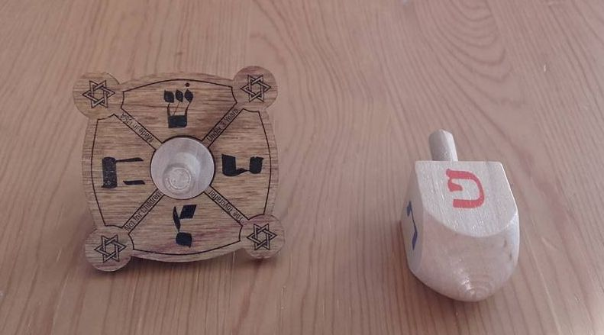
Intellectual activities
Logic puzzles
Correcting errors
Twenty questions about objects or people
Finding differences and giving reasons for them
Marjorie Rosenberg
www.elt pics

Slide 11
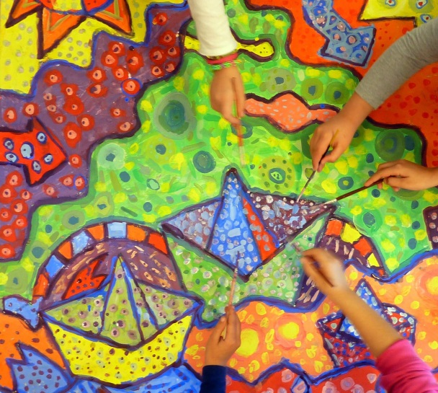
Making Lessons Creative
Using music and art
Story telling
Drama techniques
Imagination
Fantasy identities
Designing rooms, homes, places
Let learners work in groups and bounce creative ideas off each other
Iliana Bardi
Notes:
Explain ‘design your own home’ in groups – explain fantasy identities

Slide 12
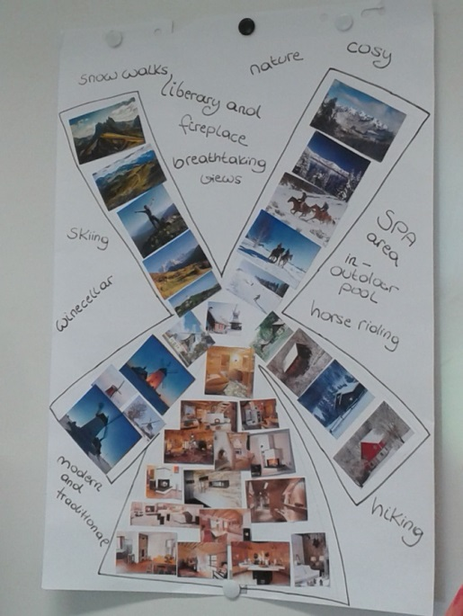
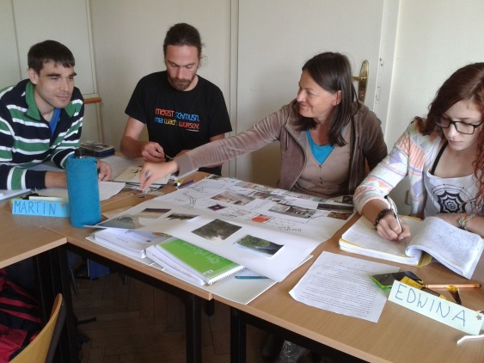
Creative activities
Play music - show pictures – let learners create a story
Pass on information about each other – change it slightly and pass it on again
Use fantasy identities – each learner chooses his/her own
Design a home for a group
Students at the
University of Graz

Slide 13
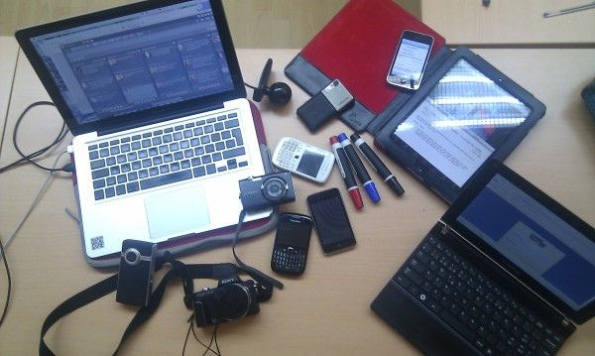
Making lessons Relevant
Current events
Up-to-date topics
Purposeful
Real-life examples
Guests
Student presentations on topics of interest
Be aware that there may be taboo topics for some learners
Graham Stanley
www.eltpics
Notes:
Finding photo on phone to show to others – talk about it

Slide 14
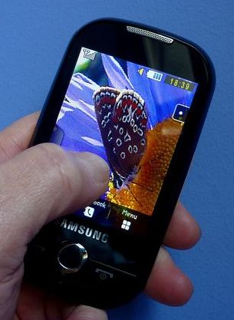
Relevant activities
Elicit topics from learners – gather vocabulary – set up debates
Invite guests to the class – learners ask questions
Start discussion of up-to-date topic – use dice to elicit answers from learners
Learners choose photo on phone – others ask questions about it
VictoriaB52
www.eltpics

Slide 15
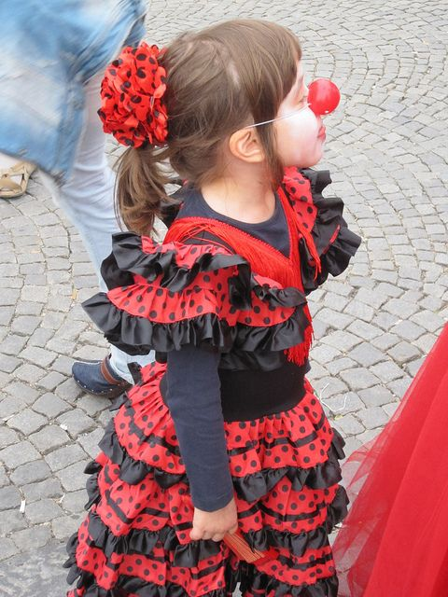
Making Lessons Fun
Jokes
Silly answers
Card games
Guessing games
Word puzzles
Cartoons
Memory games
Remember some will want to take learning seriously
Sandy Millin
www.eltpics
Notes:
Explain putting cartoons together in groups – talking about what they see – deciding on order – using jokes to find pairs

Slide 16
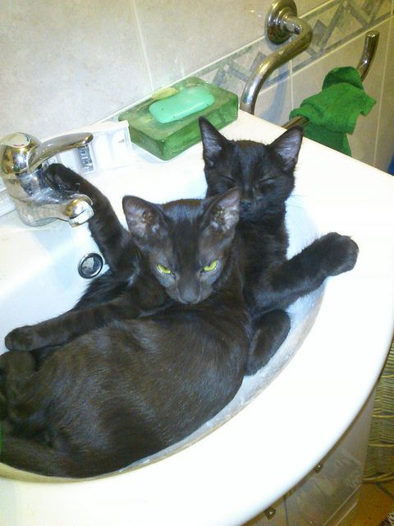
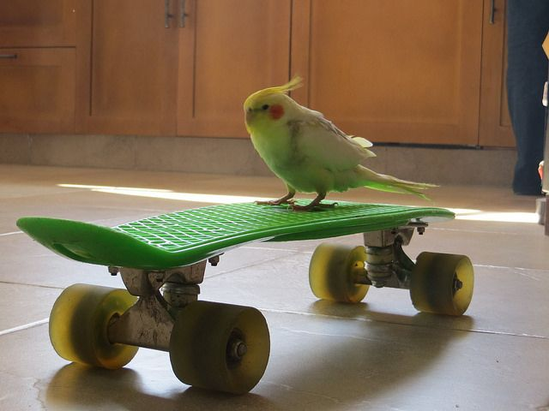
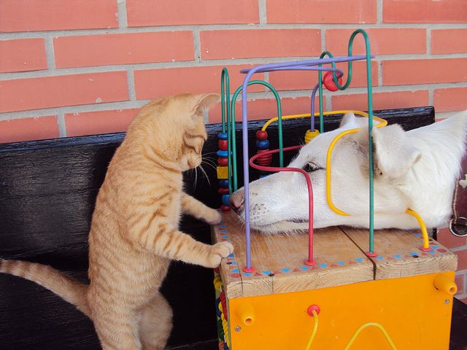
Fun activities
Find games which require silly answers
Use jokes to find pairs
Put cartoon together
Write captions to silly pictures
@senicko
www.eltpics
Emma Newman Segev
www.eltpics
@fionamau
www.eltpics

Slide 17
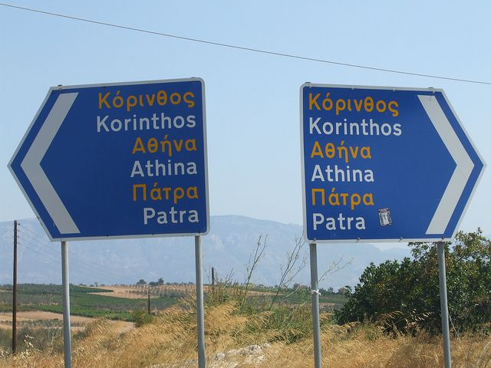
Making lessons Varied
Different forms of input and output
Mix of methods
Cooperative learning
Forming new groups
Some will be more comfortable with one or another method
Victoria B52
www.eltpics
Notes:
Explain using different styles for input – output, songs and texts or movement, explain cooperative learning, method mixes

Slide 18
Varied activities
Gap text with cards for song
Cooperative learning – change groups
VAK telephone game
Person 1
Makes pose
Person 2
Draws pose
Person 4
Makes pose & compares
Person 3
Describes post to Person 4

Slide 19
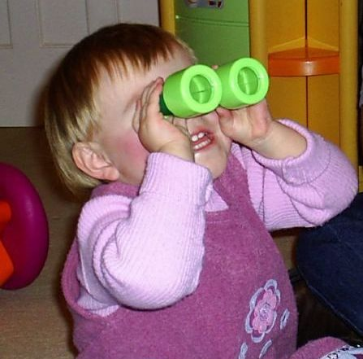
What makes Lessons memorable?
Contribute to motivation
Relevance to real life
Fires the imagination
Storage in different systems (VAK)
Something to take out of the classroom and apply
Allows learners to experiment and play with language
Engage, enhance and energise learners
@worldteacher
www.eltpics

Slide 20
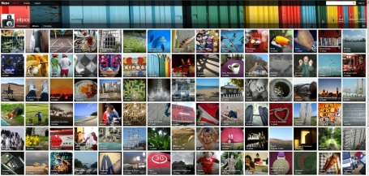
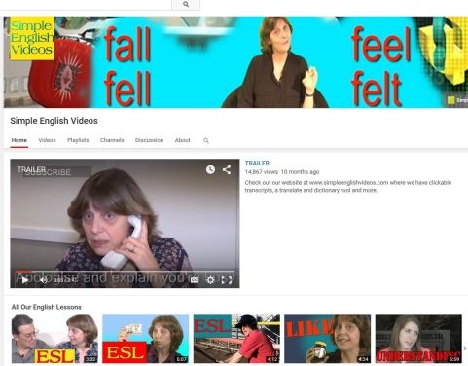
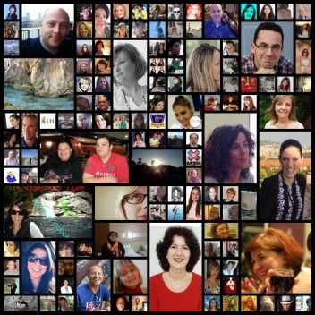
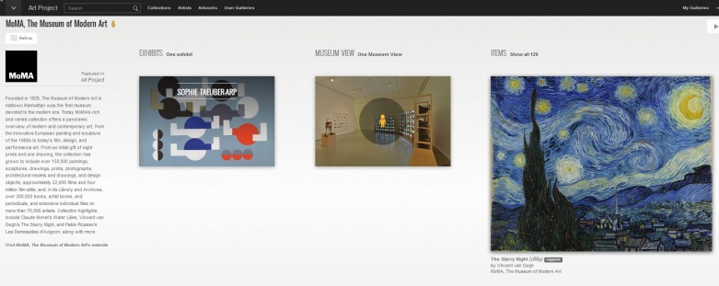
Sources and resources
Eltpics
TED talks
Disabled Access Friendly Campaign
Google art project
Vicki Hollett videos
PLN
Facebook
Twitter

Slide 21
Relfection
What element can you easily add to your classroom?
Why?
How will you implement this?
@vale360
www.eltpics

Slide 22
Marjorie.rosenberg@tele2.at
Thank you for your Attention
@SueAnnan
www.eltpics

Slide 23
Acknowledgements
Eltpics: photos taken from http://flickr.com/eltpics by Sue Annan, Martin Eayrs, Sandy Millin, Marjorie Rosenberg, Chuck Sandy, Emma Newman Segev, Graham Stanley, Victoria B52, @elt_pics, @fionamau, @senicko, @vale360, @worldteacher, used under a CC Attribution Non-Commercial license, hppt://creativecommons.org/licenses/by-nc/3.0/
Photo: Students at the University of Graz
Photo: Iliana Bardi
Screen shots of eltpics, Disabled Access Friendly Campaign, TED Talks, Vicki Hollet videos, PLN by Roseli Serra

