Slide 1
Integrating Digital Technology with Special Needs EFL Pupils Selected apps, extensions & sites to help struggling learners
ETAI (English Teachers Association of Israel)
International Conference
Ashqelon July, 2016
Dr. Melodie Rosenfeld
melorose@gmail.com
With: Avivit Sugavi-Melnitsky

Slide 2
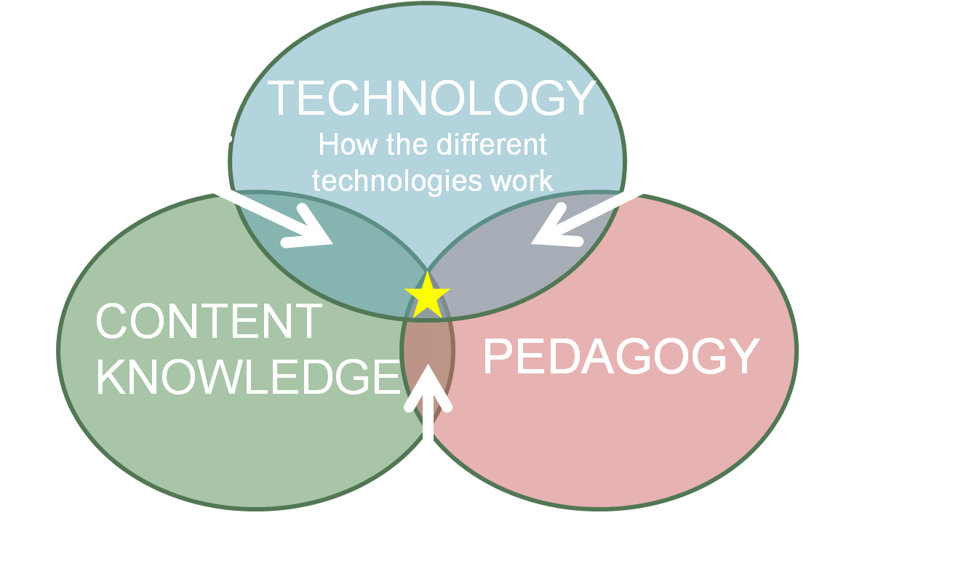
Effective teachers think FIRST: Content & Pedagogy.
THEN add Technology tools if appropriate
“TPACK”
http://www.sciencedimension.co.uk/tag/tpack/

Slide 3
1. Effective teachers first start with CONTENT
General (4-Language Skills) Areas
Specific skills
Reading
Reading
Vocabulary
Writing –
Writing –
Writing -
Listening –
Speaking –
Study skills –
Motivation –
decoding letters & words, sight-words, sentences…
comprehension of words, sentences, stories…
Wide range, strategies to “guess” in context
handwriting: legibility, speed, quality
mechanics: spelling, grammar…
Vocabulary, sentences, paragraphs, essays, stories
vocabulary, comprehension
vocabulary, fluency, accuracy, motivation
organization, strategies to “work smarter, not harder”
to practice, to improve EFL

Slide 4
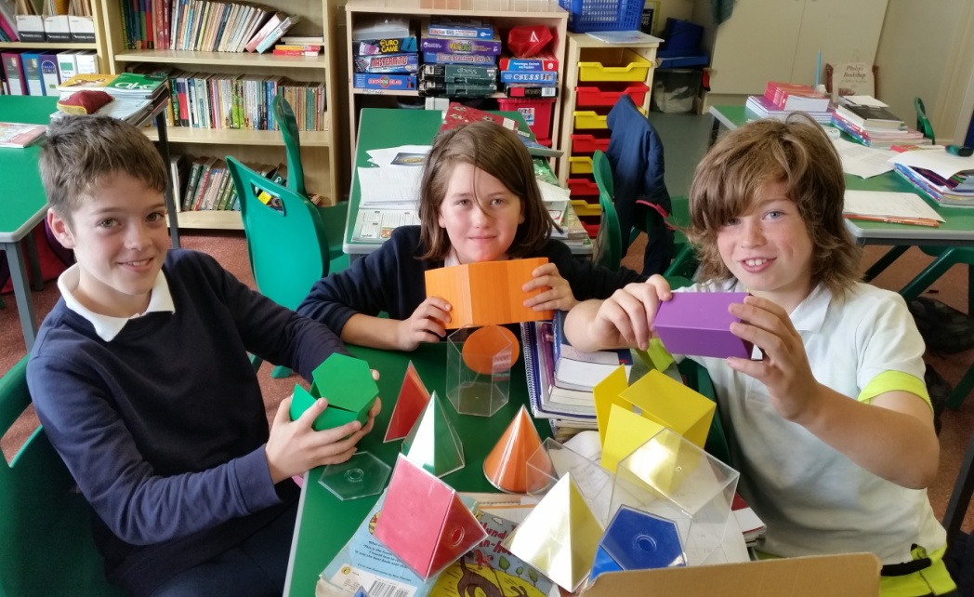
2. Then, effective teachers think about Pedagogy
Teacher active: frontal teaching
Learners active: discovery learning, project-based learning…
Individual tutoring
Groups
Hands-on learning

Slide 5
3. Only then, effective teachers think about Digital Technology
And ONLY if tech…
Enhances the Content (help learners learn)
Enhances the Pedagogy (help me teach better)
Motivates learners to learn the content

Slide 6
Example A
Content
Writing correct English sentences.
Pedagogy (without tech)
Teacher
Explains, gives rules, models good sentences
Learners
Do homework, class-practice, tests…

Slide 7
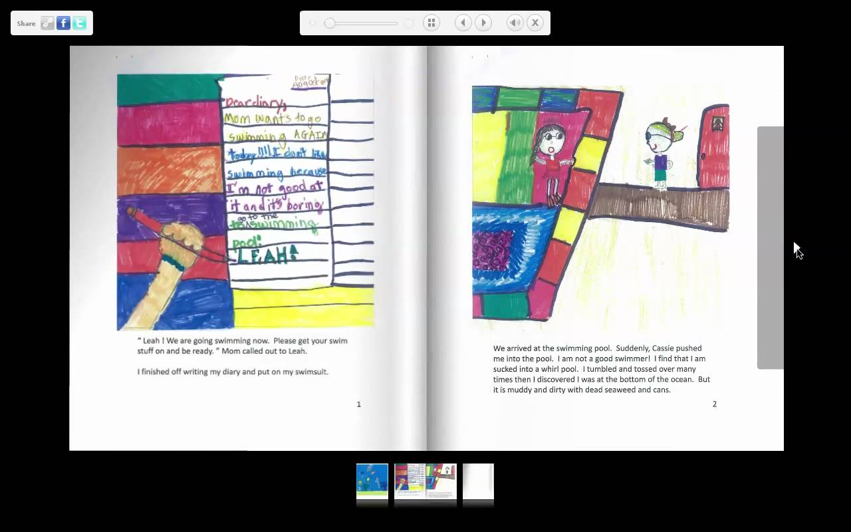
What Digital Technology can enhance content & pedagogy for writing?
OurBOOX Digital Books
Pupils…
write multiple drafts (saved in a portfolio) of a story.
correct sentences before publishing.
publish finished flip-book story with correct sentences.
upload their books to the school site & share.
Example:
“My Neighbor’s Dog” by Hodaya Cohen-Dega
http://www.ourboox.com/books/my-neighbours-dog/
Also see: http://www.flipsnack.com

Slide 8
Next slides…
Only free & “lite” apps (not “premium”)
Selected | Examples
Extensions | Microsoft SpellCheck (turn on/off)
Applications | Morfix (translation)
Sites | BBC LearnEnglishKids

Slide 9
Content Areas (especially for struggling learners)
1. Phonics skills
2. Sight words
3. Spelling
4. Vocabulary
5. Texts on different levels
______
6. English megasites

Slide 10
PHONICS apps
URL | Tech app name
http://www.fun4thebrain.com/English/magice.html | Fun4TheBrain: Magic E Treasure Hunt
http://www.kizphonics.com/phonics/digraph-sh-phonics-game/ | KIZ phonics. Digraph sh game
http://www.starfall.com/n/level-a/learn-to-read/load.htm | Starfall “Learn to Read” Phonics rules, stories
http://www.funfonix.com/games/book1menu.php | FunFonix short vowels & blending

Slide 11
SIGHT WORD apps
URL | Tech app name
http://www.abcya.com/dolch_sight_word_bingo.htm | ABCya Dolch sight word bingo
https://play.google.com/store/apps/details?id=au.com.sightwords.parrotfish.lite | Play.Google App store Parrotfish sight words. K level
http://www.spellingcity.com/dolch-words.html | Dolch words (SpellingCity)

Slide 12
SPELLING apps
URL | Tech app name
https://play.google.com/store/apps/details?id=com.ananiya.myspelling&hl=en | Play.Google My spelling test
http://www.aaaspell.com/ | AAA Spell
http://www.spellingcity.com/ | Spelling city
http://www.manythings.org/e/abc.html | ManyThings.org for ESL: spelling
https://howtospell.co.uk/top-ten-spelling-rules | HowToSpell 10 top spelling rules video

Slide 13
VOCABULARY apps
URL | Tech app name
www.vocabulary.com | Vocabulary.com
http://www.manythings.org/lulu/ | ManyThings.org ESL vocab games
http://teacher.scholastic.com/clifford1/flash/concentration/index.htm | Clifford memory game Reading rules, spelling, vocab
http://more2.starfall.com/m/level-k/word-machines-demo/load.htm?f&n=machine&d=demo | Starfall word machines game
https://quizlet.com/ | Quizlet
https://www.youtube.com/watch?v=pFFv6_6was4 | Kahoot quizzes

Slide 14
TEXTS on different levels
URL | Tech app name
www.ReadibilityScore.com | Determine USA reading level score of any text
www.Rewordify.com | Simplify words of a text (same text, different levels)
http://www.k12reader.com/worksheet/extreme-weather/view/ | K-12 reader site
http://www.starfall.com/n/level-b/magic/play.htm?f | Starfall
http://www.eslfast.com/begin3/b3/b3002.htm | ESLFast; getting ready to read; grades 5-6

Slide 15
English MEGASITES (a)
URL | Tech app name
https://www.vocabulary.com/lists/ | Vocabulary.com
http://pbskids.org/lions/games/messyattic.html | Ronit Hetzroni Flash cards, games…
https://learnenglishkids.britishcouncil.org/en/word-games?page=0%2C1 | British Council LearnEnglishKids
http://more2.starfall.com/m/level-k/word-machines-demo/load.htm?f&n=machine&d=demo | Starfall Word Machines
http://www.manythings.org/e/abc.html | ManyThings.org for ESL

Slide 16
English MEGASITES (b)
URL | Tech app name
http://www.amalnet.k12.il/meida/english/karon.htm | AmalNet English CyberCar Links & games
http://www.baumgarten.022.co.il/BRPortal/br/P100.jsp | Ora Baumgarten digital portfolio Links to other sites
http://www.kaye7.org.il/english2.htm | Kaye College English Links to other sites
http://www.orianit.edunegev.gov.il/ronit/cp/homepage/games.htm | Orianit Links for EFL
http://www.agendaweb.org/ | AgendaWeb. Middle school+ Study skills, songs…
http://www.studygs.net/ | Study Guides & Strategies (middle to adult)

Slide 17
English MEGASITES (c)
URL | Tech app name
http://www.readwritethink.org/classroom-resources/student-interactives/venn-diagram-30973.html | ReadWriteThink vocabulary
http://www.orianit2.edunegev.gov.il/chazonasd/sites/homepage/victoria/page1.htm | Victoria’s English page
http://www.ecb.co.il/Page.aspx?PageID=795 | Eric Cohen Books sites, activities, games…
http://eduteach.es/ | EduTeach Videos, songs

Slide 18
More useful apps & extensions (a)
 | Extensions, apps
Type font for dyslexic readers | Dyslexie extension
Let pupil choose colors Cream paper + blue type 14+ size font | GoogleDocs: Changing page colors & type
Writing tool for dyslexics | Google Chrome "Voice Typing“
Free grammar checker | Grammarly extension

Slide 19
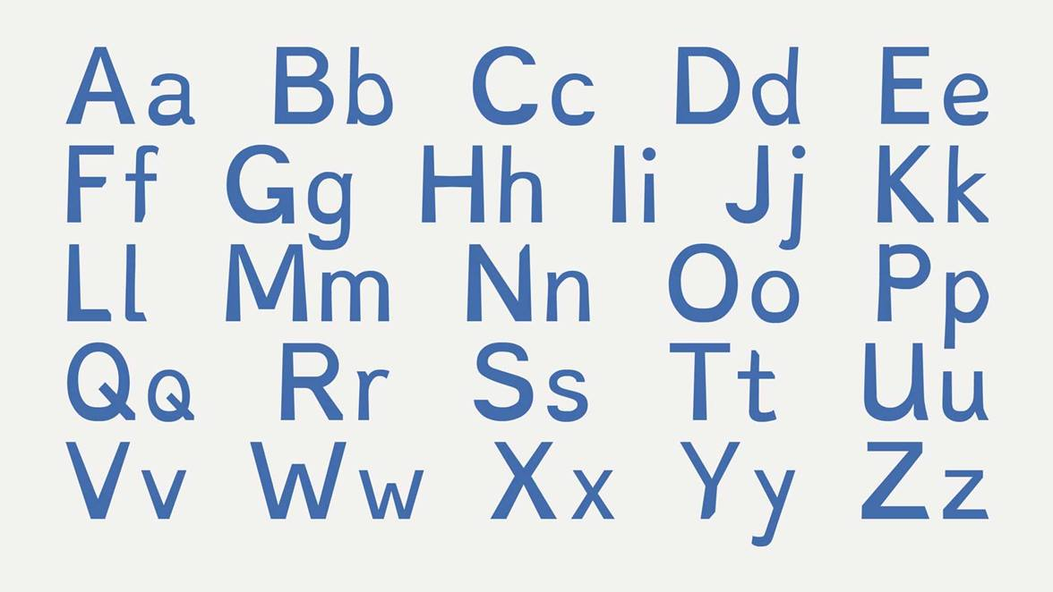
Extension
OpenDyslexic.org/
Free, open dyslexia typeface

Slide 20
More useful apps & extensions (b)
Kid internet search engines
Safe, visual internet items | Kiddle search engine
Switch news stories to 5 levels | Newsela news on levels

Slide 21
More useful apps & extensions (b)
For teachers
Quietube link | Only show your YouTube clip, not ads
TinyURL link | Enable pupils to copy a URL easily from the board, a paper, a ppt…
TubeChop link | Chop only the YouTube selection you want (e.g. minute 7.3 – 8.1)
Pinterest boards | Collect & find millions of teacher-recommended sites & activities https://www.pinterest.com/melorose13/
Hivve | Keep in touch with your tutoring pupil & groups

Slide 22
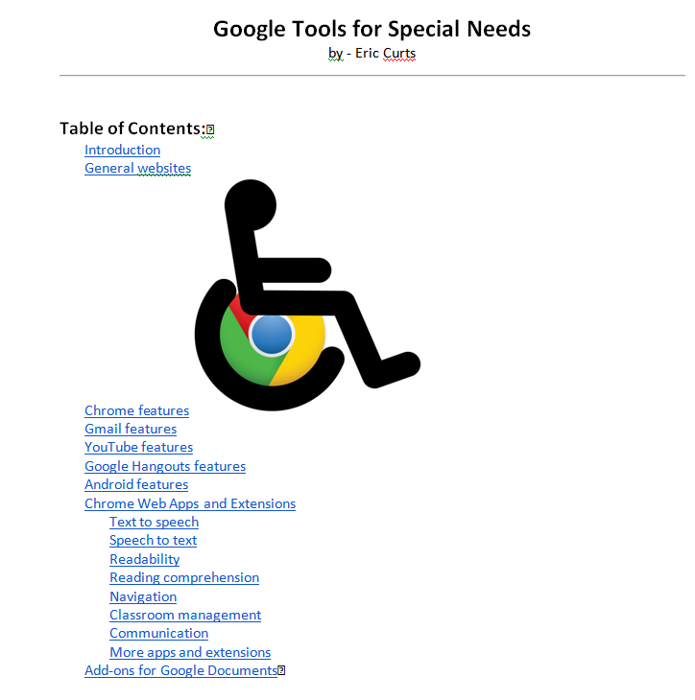
http://ti.apps.sparcc.org/videopd/20150224-special-needs
Webinar

Slide 23
Assistive Technology for LD
http://www.ldonline.org/article/33074/
Listening
Organization and memory
Reading TLDR: too long, didn’t read
Writing
Abbreviation expanders
Alternative keyboards
Audio books and publications
Graphic organizers and outlining
Information/data managers
Optical character recognition
Portable word processors
Proofreading programs
Speech-recognition programs
Speech synthesizers/screen readers
Talking calculators
Talking spell checkers and electronic dictionaries
Variable-speed tape recorders
Word-prediction programs

Slide 24
Final words
Remember TPACK
Use tech appropriately
Try a “flipped classroom” approach
Try free & “lite” apps (vs. premium)
Be patient: It takes ALL of us a while to learn a new app
Enjoy!
Melodie & Avivit

