Slide 1
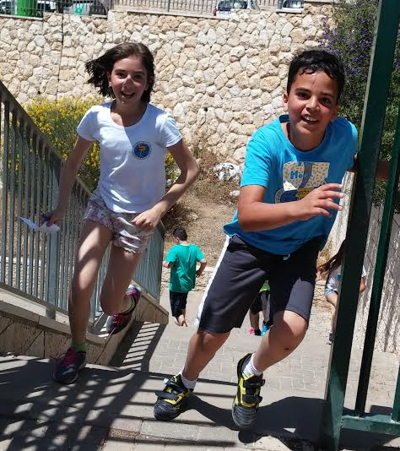
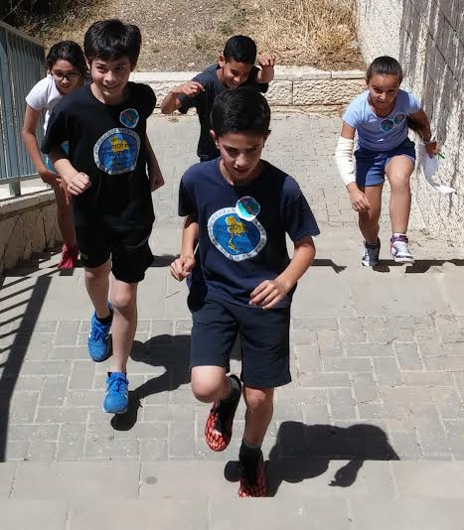

The Amazing Race for Words
Manchi and Jerusalem Inspectorate

Slide 2

The game rests on four main principles:
Team work
Heterogenous groupings
Vocabulary reinforcement and enhancement
Increasing motivation

Slide 3
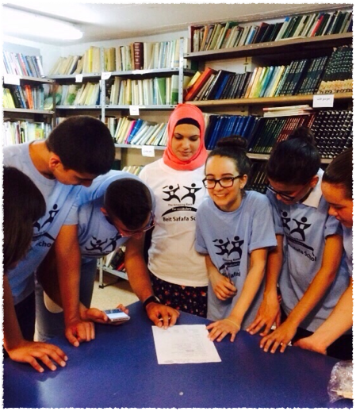
Pupils are divided into mixed ability groups
4-5 pupils in each group
Home room teachers can be asked to help divide the groups

Slide 4
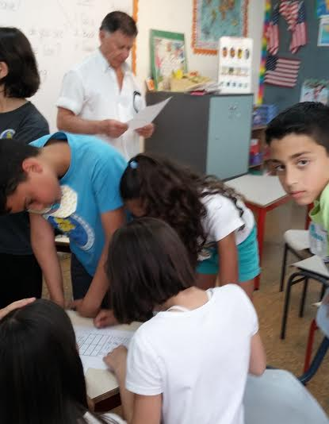
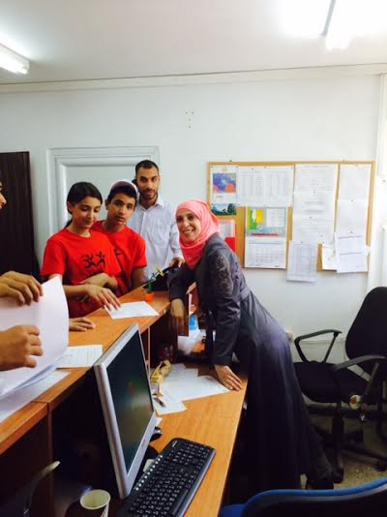
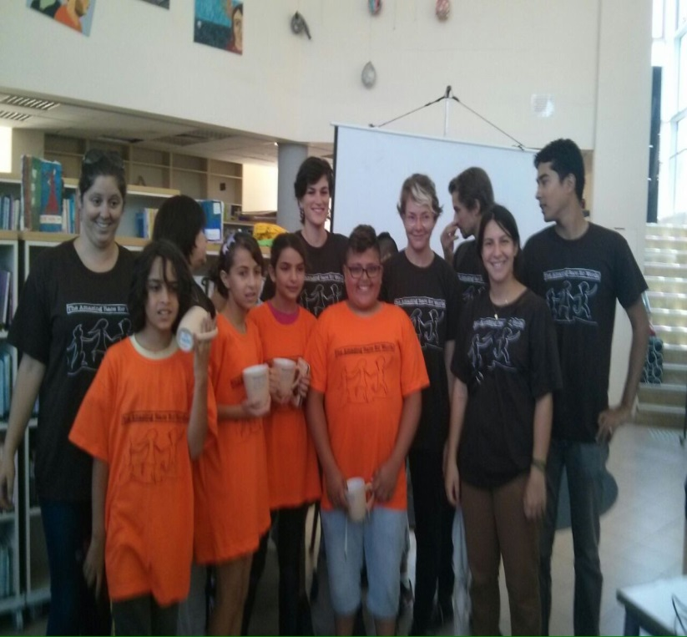
The success of the game depends on getting as many members of English and/or non-teaching staff involved.

Slide 5
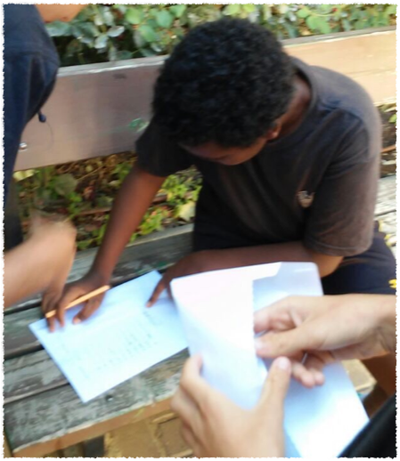
For a grade consisting of 50 pupils , there are ten groups and ten stations.
At each station, pupils are required to do a variety of tasks based on vocabulary taken from appropriate lexical lists.

Slide 7
Instructions
Pupils receive instructions from their home room teachers, therefore we attached a file in Hebrew.
Each group has a name and the pupils receive a sticker with the name of the group.
In one school, pupils received different coloured T-shirts with a game logo!!
Each group receives a game card.

Slide 8
 | Name of group: Starting Time: Finishing Time:
Station # | The stickers go here: | Points (to be filled in later)
1
2
3
4
5
6
7
8
9
10

Slide 9
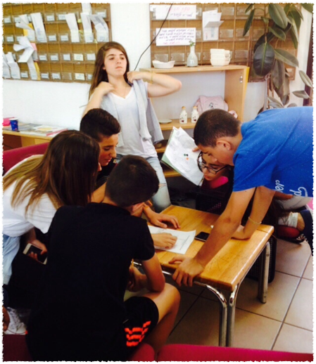
Groups are sent out at intervals of 2-3 minutes.
Each group receives a different clue.
Pupils arrive at stations according to rhyming clues in simple English.
When the pupils arrive, the staff member must check that the pupils have arrived with the correct clue and then takes the clue and gives the pupils the task.

Slide 10
Please make sure that the pupils arrive at your station with the correct clue.
Please take the clue from them.
Give the pupils the assignment in English.
Make sure the pupils write the name of their group on the assignment.
They should try to finish in 7 minutes.
They may use a dictionary if they choose.

Slide 11

When they complete the assignment, they must return it to you.
Give them a sticker to put on their game cards next to the number of your station.
Give them the next clue.

Slide 12
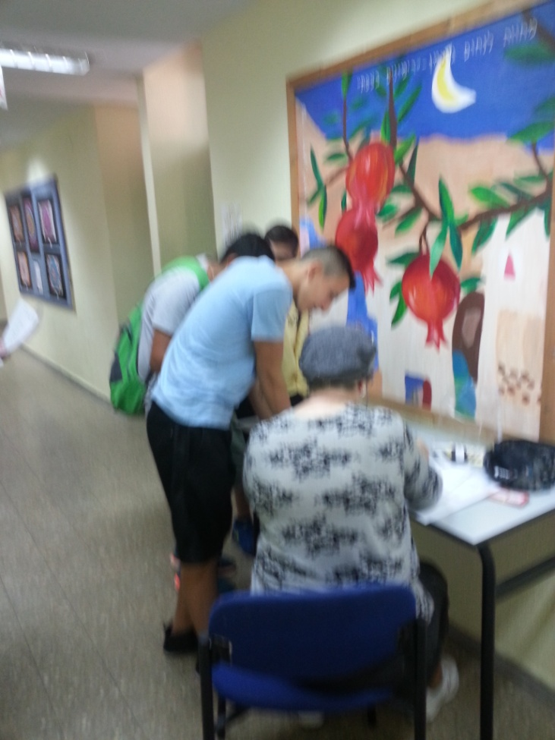
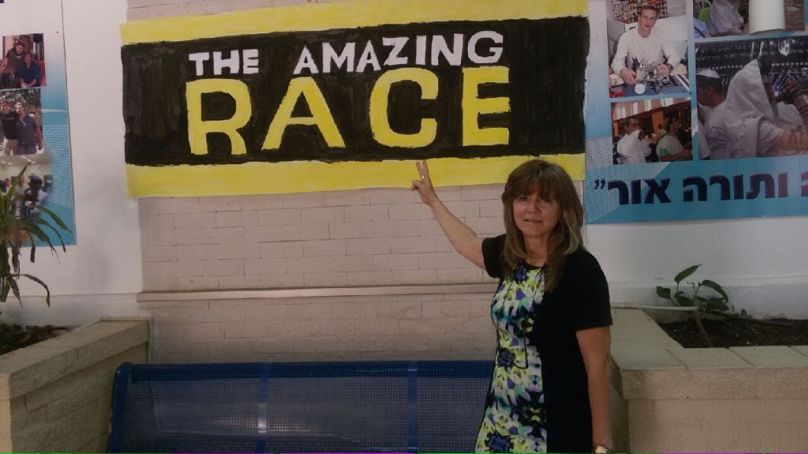
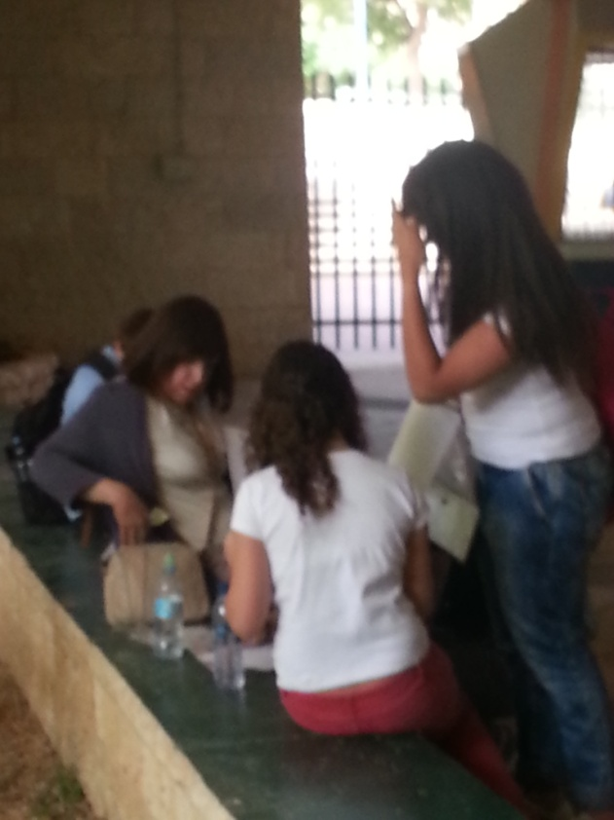
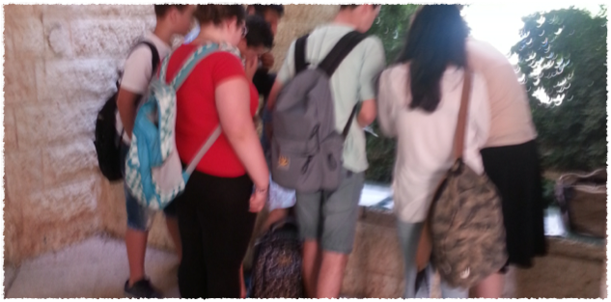
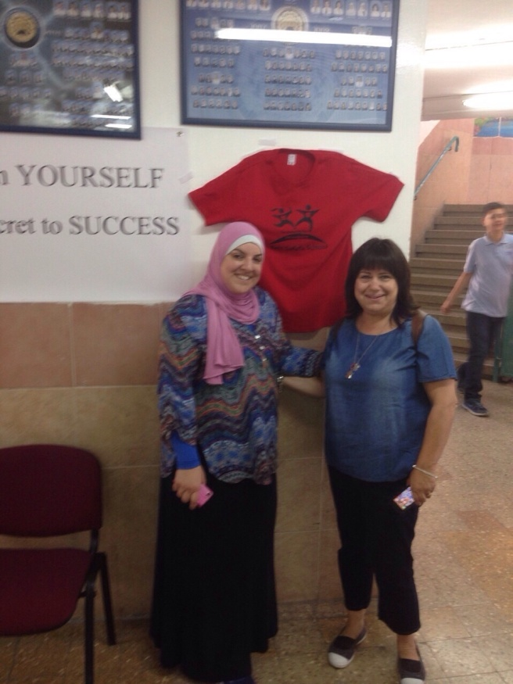
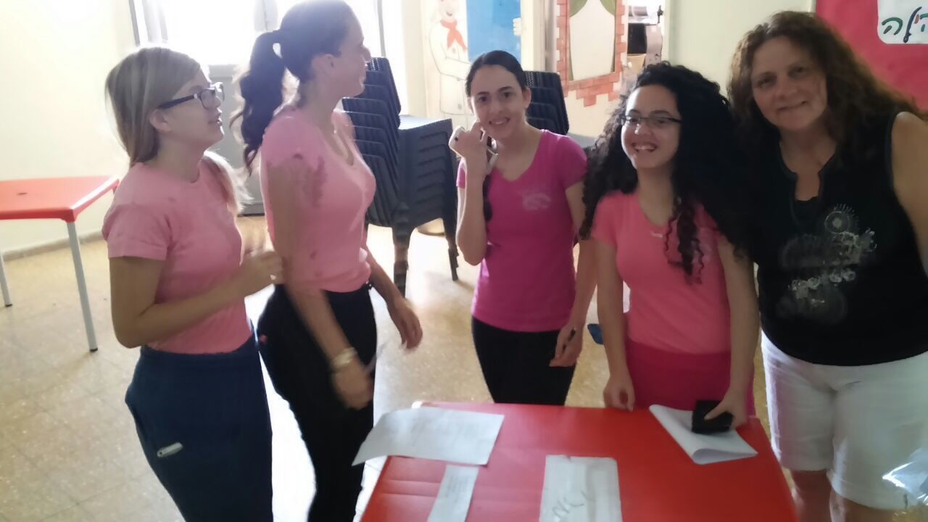
Once they have all ten stickers, they return to a staff member waiting by their classroom who writes down their time of arrival.

Slide 13
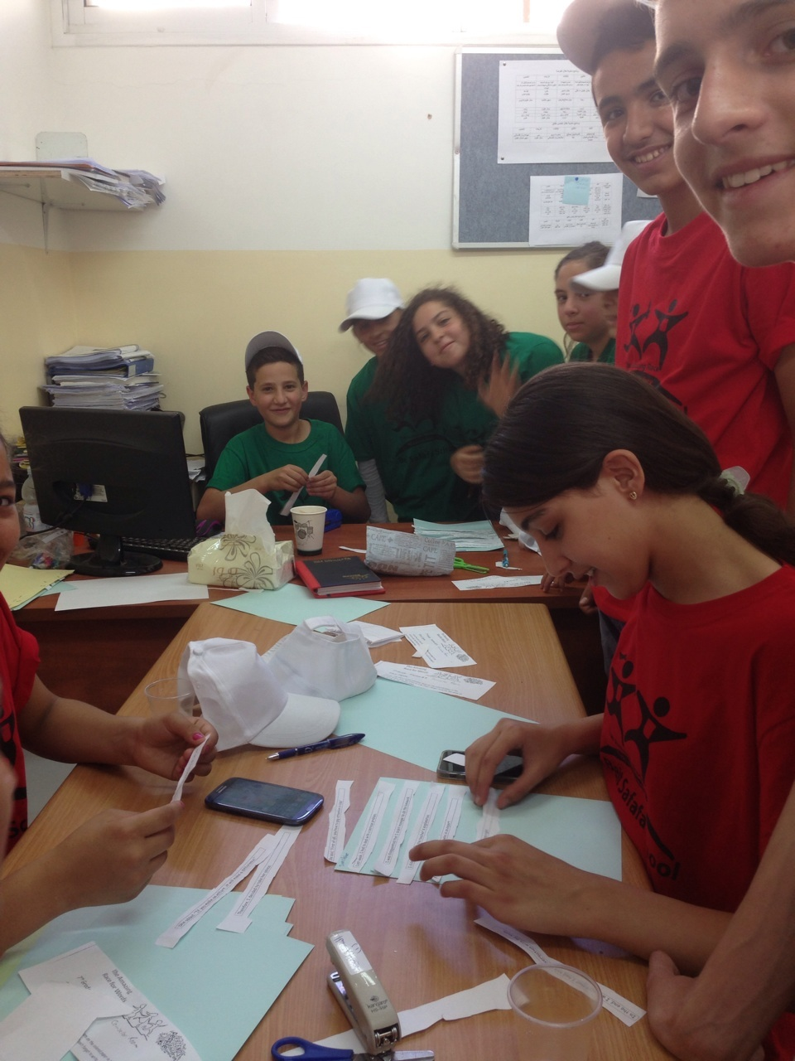
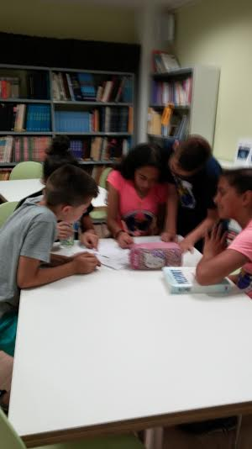
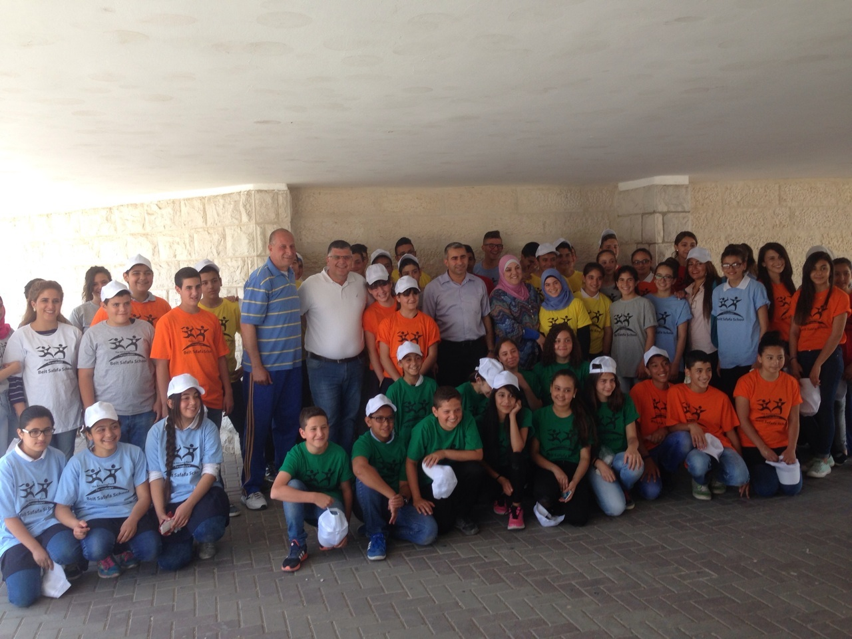
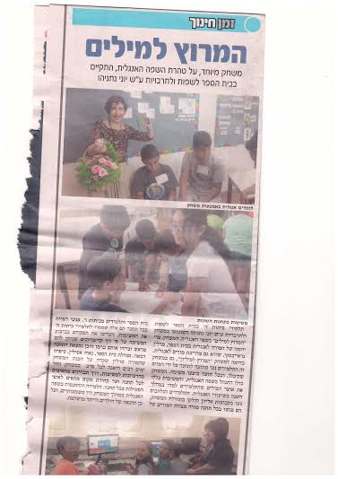
The fun everyone had!!!!!

Slide 14
The pupils enjoyed the game. They loved the competition and completed the tasks excitedly and happily. We will be happy to do it again next year.
It was a pleasure to see that once the groups were formed they were running from station to station, enjoying every minute of it. There was cooperation (and new friendships were made
For me the Race was another opportunity to see the English staff at their best and we are certainly going to use it again.
Last but not least, it was good PR with the management and many homeroom teachers thanked us for the activity; keeping the pupils busy the last two weeks is always a challenge!

Slide 15



In order to choose the winning group we need the feedback on how well they worked together.
The staff member at the station must complete this:
Checklist for Evaluation of Group Collaboration
טבלת הערכה של מידת שיתוף פעולה במהלך המשחק
How well did each group work together?
Name of group _______________________
Did they…… האם התלמידים........
talk to each other politely? דיברו בנימוס אחד לשני?
listen to each other? הקשיבו אחד לשני?
encourage each other? עודדו אחד את השני?
involve each group member? שיתפו את כל חברי הקבוצה?
relate to the task? התייחסו למשימה?
work in an orderly fashion? עבדו באופן מסודר?

Slide 16

Now let's play Kahoot!

