Slide 1
Teaching Writing as-a-Process
Action Research
Mir Geva
Instructor: Dr. Maureen Rajuan
Achva Academic College, 2014

Slide 2

The product-oriented approach
structured
organized
Grammatically correct
on the pupil's first attempt
The result = pupils might feel overwhelmed or incapable of coping with such high and somewhat stressing demands, and they may avoid writing altogether (Ho, 2006).
The result = pupils might feel overwhelmed or incapable of coping with such high and somewhat stressing demands. As a result, pupils may avoid writing altogether.
(Ho, 2006).

Slide 3

The writing-as-a-process approach
since the 1960s
Going through several stages of drafts before reaching the final product is an important and valuable language learning tool.
When writing is approached in a way that emphasizes the content rather than the grammatical and structural form, a wider platform is presented to the pupils, allowing them to explore and develop their ideas to the fullest
(Ho (2006).
Writing is an important part of the human emotional and social life, and as such it should be presented to learners from a young age as a learning experience (Sultan, 2009).

Slide 4
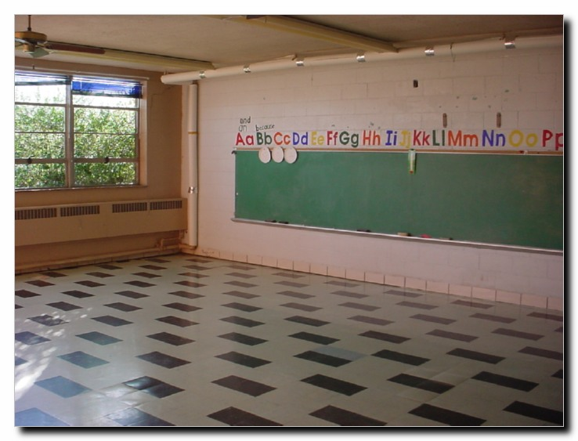



The role of the teacher
Instructor
Motivator
Directing the classroom to a more
pupil-oriented learning environment.
Encourages the 'writing juices'.
The writing teachers' new tasks are:
Choose a motivating assessment system.
Introduce the pupils to draft-writing techniques.
Choose meaningful and authentic writing topics and
Teach grammar, structure and style inductively.
(Mourssi, 2013).

Slide 5
Method - Setting and participants
9th
^{grade}
Darka
(southern Israel)
‘A’ level class
30
pupils
25
Lessons
during one year
Observed by : peers and pedagogical instructors

Slide 6


Action plan
the Sun Diagram
self- evaluation
The “Writers Matter” Project
brainstorming
My Future
I Am
Friendship
My Family
paragraph structure
writing games
forming a main idea
writing prompts
peer editing
songs, clips, pictures

Slide 7
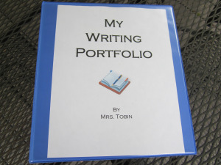
Using Pupils’ Portfolios
Where:
The pupils collect their drafts.
Teacher and pupil can correspond with each other in writing.
The pupil’s writing process can be monitored both by pupil and by teacher.
A great presentation tool of the pupils’ writing.

Slide 8
Assessment of action
questionnaires
Pedagogy dairy
RESULTS
Pupils’ portfolios

Slide 9

Date: __________
Did you enjoy the writing activity in the lesson? Yes / No
Did the writing activity help you write? Yes / No
Is your writing getting better? Yes / No
Does the use of drafts help you write well? Yes / No
What would help you improve your writing?
_____________________________________________________________________________________________________________________________
What's on your mind?
_____________________________________________________________________________________________________________________________.
Questionnaire

Slide 10
Results
Does the use of drafts help you write well?
At the beginning of the year: 67%
What would help you improve your writing?
1. Practice
2. Vocabulary
3. Songs
What would help you improve your writing?
1. Relationship with the teacher (trust)
2. “Open your heart & mind.”
3. Practice
At the end of the year: 85%
questionnaires
At the beginning of the year
At the end of the year

Slide 11
Pupil X’s writing
(taken from her portfolio)
First drafts
Final draft
Our memories make us who we are
With out memory we can’t love, can’t hate. We will be nothing because we will have not something to live for.
Beautiful memories makes us loyal to the things we love.
I can’t forget people that help me when I need the most because of that I will allways help.
So we neer always remember the past we always need foeget the worst for that we live
Our memories make us who we are.
Without our memories we can't love, can't hate. We will be nothing, because we will have nothing to guard, to live for.
Beautiful memories make us loyal to things, to people, to our selves.
Exactly in the same way, painful memories they make us stronger.
Somehow I can't forget people that helped me when I needed the most. Because of that I will always help others as long as I can.
The people we love, they are who we are. They can hurt us or help us.
Even if I am in the worst place, as long as I remember, I will be fine.

Slide 12

Pedagogy instructor's feedback
Make your lessons more pupil-centered!!!
Provoke, motivate and encourage creative writing!
When you plan a lesson, ask yourself what the pupils will do!!!
Use the board to create a rich word and phrase writing bank!
Moderate your praise!
Model good writing by avoiding spelling mistakes!

Slide 13
Conclusions
The Writing as-a-process approach should be introduced to the pupils at the beginning of the year.
The writing strategies such as : writing prompts, brainstorming, peer editing and paragraph writing are wonderful tools that can be adjusted to any level or any learning style.
Building relationships with the pupils which are based on trust, consistency, mutual respect and good writing habits are crucial for teaching writing.

Slide 14
Learn what you teach and teach what you have practiced”
(Mir, 2014)
What have I learned?

Slide 15
Recommendations for teaching
Start teaching writing as a process at the beginning of the year.
Create a positive non- judgmental writing environment.
Respond to your pupils’ writing with writing, not with grades, or red corrections.
Teach the pupils to evaluate their own writing.
When possible, widen the writing topic, so every pupil can find their own writing topic and style.
And remember: writing is fun ☺

