Slide 1
Assessment? As Easy as 1-2-3!
Dr. Judy Henn
The Technion

Slide 2
What is Assessment?
A wide variety of methods used to
evaluate
measure
document
WHAT?
academic readiness
learning progress
skill acquisition¹

Slide 3
Types of Assessment
Formative Assessment is ongoing, providing information to adjust teaching and learning
EXAMPLES:
Projects and performances
Writing assignments
Tests and quizzes
Asking questions

Slide 4
Summative Assessment focuses on a point in time, such as a test
EXAMPLES:
A senior recital
A final project
A midterm paper or exam

Slide 5
Who Needs Assessment and Why?
Every institution, agency and organization should measure to determine:
PROGRESS
and to insure
ACCOUNTABILITY¹

Slide 6
What Should Be Assessed?
Identifying the task (product, performance, or assignment)
Breaking down the task into measurable elements
Executing the task correctly

Slide 7
Examples of Tasks
Product: Decorate a flowerpot as a gift for Family Day
Performance: Choose a poem from the text, learn it by heart, and recite it
Assignment: Write a book report

Slide 8
What Task Aspects Can Be Measured?
Flowerpot (hint - use of color)
Poem (hint - use of oral expression)
Book Report (hint - brief summary of the conflict)

Slide 9
What are Rubrics?
An assessment tool that:
lists the aspects of the task to be evaluated
notes the specific criteria used to evaluate each aspect
describes the levels of quality
assigns a point value to each level²

Slide 10
Why Use Rubrics for Assessment?
Best for subjective assessment (presentations, portfolios, projects)
Teacher’s expectations are clear to student
Students can evaluate the quality of their work
Reduces marking time²

Slide 11
What Are the Criteria?
Dependent upon the learning goals and purpose of the assignment
1. Observable and measurable: “The report covers all assigned material”
2. Important and essential³: “Paragraph spacing was strictly observed”

Slide 12
3. Distinct from other criteria: “Spelling was correct”
4. Phrased in precise, unambiguous language³: “All 3 types of music were mentioned”

Slide 13
The Rating Scale
Link the rating scale to your purpose -
For example:
Below expectations
Meets expectations
Exceeds expectations OR
Beginning
Developing
Competent
Accomplished

Slide 14
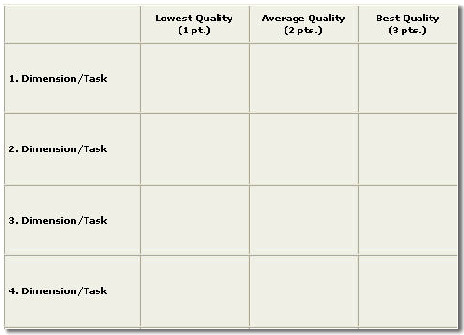
How to Create a Rubric

Slide 15
Criteria | Beginner | Competent | Expert
Recipe Followed Correctly | Incorrect proportions. | Proportions are nearly correct. | Pie has the correct proportion of sugar and spices for the amount of apples and size of pie.
Apple Filling | Preparations not carried out correctly. | Preparations done mostly correctly. | Apples were cut and prepared correctly for even baking.
Crust | Crusts are thick and/or soggy. | Crusts are not light or flaky enough. | Top and bottom crusts are light and flaky.
Baked Evenly | Baking time incorrect; pie under or over done; crust raw or burned. | Baking time is nearly right; pie is not completely baked; crust is not brown enough/too brown. | Pie is baked for the correct amount of time, pie is evenly baked throughout, and the crust is golden brown.

Slide 16
References
The Glossary of Education Reform http://edglossary.org/assessment/
Creating a Rubric: Tutorial http://health.usf.edu/publichealth/eta/Rubric_Tutorial/default.htm
http://www.ucdenver.edu/faculty_staff/faculty/center-for-faculty-development/Documents/Tutorials/Rubrics/3_creating/3_characteristics.htm
Assessment for Learning Strategy http://webarchive.nationalarchives.gov.uk/20130401151715/http://www.education.gov.uk/publications/eOrderingDownload/DCSF-00341-2008.pdf

Slide 17
I welcome inquiries
Dr. Judy Henn
henn_judy@yahoo.com

