Slide 1
Teaching Novels in a Novel Way: Arts Integration in the Secondary Classroom
Donna Feldman, Ph.D.
DBGFeldman@gmail.com
Notes:
Good morning. I can still remember the first time I attempted to teach a novel to high school students. I was teaching in an alternative school at-risk teens and had students who could barely get through short stories. The thought of teaching a novel sent chills up and down my spine. It took the teaching a couple of novels to develop successful methodology. My name is Donna Feldman, and today, I’m going to share some of that methodology with you in this presentation – “Teaching Novels in a Novel Way: Arts Integration in the Secondary Classroom”.
School districts audience is from – and grade level.
Urban?
Suburban?
Rural?
Middle school?
High School?
Any one else?

Slide 2
My Presentation
The Problems of Teaching Grade Level Novels
What the Research Says
Teaching Strategies Used With Students
Results
Hands on art experience
Questions and Answers
Notes:
No other academic discipline teaches a novel except for the occasional social studies teacher.
In this session, I will present numerous arts integration strategies that successfully provided
secondary students with mastery of three complete novels; these strategies are applicable to
other literary works and integrate various art forms throughout each novel to improve
vocabulary, comprehension, reading strategies, connection to text, and text-based writings.

Slide 3
The Problems with Grade Level Teaching Novels
???
Notes:
What are some of the problems you’ve experienced with teaching a novel?

Slide 4
The Problems with Grade Level Teaching Novels
Unengaged students
Weak vocabulary
Poor comprehension
Incomplete/missing assignments
Failure
Notes:
When it comes to reading we know we have:

Slide 5
The Research
Students transfer perception, creative, and comprehension to non-arts tasks (Eisner, 1998)
Arts fosters reading in younger children (Richards, 2003)
The creation of an art project results in ownership (Kraft, 2006)
Integrating art causes students to interact with content (Lynch, 2007)
Notes:
Richards cites several studies about how the cognitive processes involved in art transfer to reading – shapes, lines, colors, and space in young children.
Lynch – (1) when students interact with content, they pay greater attention to details and gain additional perspectives; (2) sketching requires students to express understanding; and (3) art is fun.

Slide 6
More Research
Arts integration engages students by providing individual choice, autonomy, and self-regulation (Robinson, 2013)
Art integration enhances the understanding in the content area (Gullatt, 2008)
Art opens the way to high-level thinking (Nethery, 2013)

Slide 7
The Reading Process and Arts Integration
Before Reading
Teacher
During Reading
Student
After Reading (Flood & Lapp, 2000; Vacca & Vacca, 1989)
Teacher
Student
Artist

Slide 8
The Reading Process and Arts Integration
Before Reading
Teacher
During Reading
Student
After Reading
Teacher-led
Student
Artist-led
Notes:
There are distinctive places for art integration when teaching a novel.
These places align with the reading process.

Slide 9
The Novels
Ninth Grade
Animal Farm
Night
Anthem
Tenth Grade
Frankenstein
All Quiet on the Western Front
Twelfth Grade
Olaudah Equiano
The Autobiography of an Ex-Colored Man
Notes:
Please note – This is not a presentation about a research-based project but rather the observations I made when integrating arts into my secondary English classes.

Slide 10
Before Reading
Art as a hook to reading.
Presents historical and/or cultural context of novel.

Slide 11
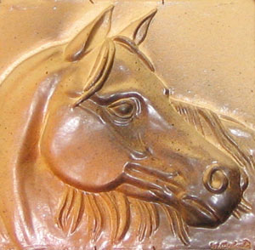
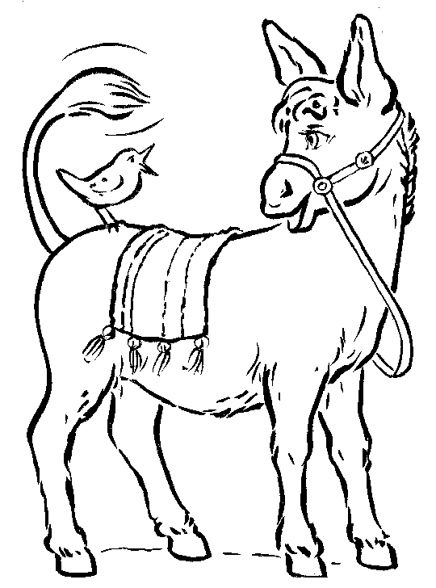
Example Before Reading – Animal Farm
WelshBlogs.com
Harmonyfineart.com
English.china.com
Hippyshopper.com
Clipartpal.com
Uniquefarm.com
Notes:
The use of illustrations introduces students to the concepts in the book (Lantz, 2005) and to different art genres. Can you identify any of the mediums on this slide?
Art mediums:
Dog is an oil painting;
Horse is a sculpted tile;
Pig is a cartoon;
Cow is a cartoon;
Goat is an abstract; and
Workhorse is a sketch.
Which animal is the smartest? Which would you want to lead you and why?
Correct answer for Animal Farm is the pig.

Slide 12
Example Before Reading - Night
Mayer Kirschenblatt ’s
Purim Play: The Kraków Wedding (circa 1994)
http://www.berkeleydailyplanet.com/photos/10-30-07/Purim%20Play,%20high%20res.jpg
Notes:
What genre of art is this? , (Acrylic on canvas.)
What do we see in this picture?
What clues are there about the culture it captures?
Emotions in the picture?

Slide 13
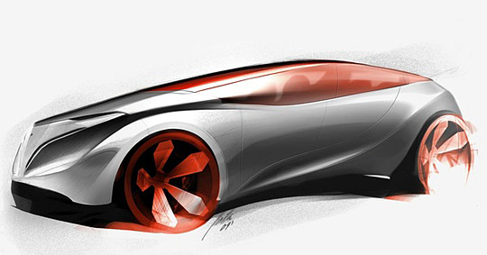
Example Before Reading - Anthem
Tesla Eye Concept by Jorge Andres PIinilla Fonseca
http://www.cruzine.com/2011/01/27/concept-cars-photography/
Notes:
Besides more streamlined cars, what other aspects of life do we expect in the future?
In the future, will we have more or less technology in our lives?
Do we think life will be more equitable in the future?
These questions provide discussion that helps introduce the themes in Anthem.

Slide 14
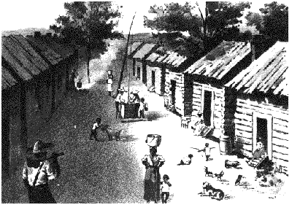
Examples Before Reading– Slave Narrative/ Abolition Literature
http://xroads.virginia.edu/~hyper/jacobs/hj-flint.htm
http://xroads.virginia.edu/~hyper/jacobs/hj-live1.htm
Notes:
Compare/contrast the house and the huts. You could make a writing assignment about these pictures as well.
Shape of huts is important when reading Harriet Jacob’s autobiography – she hid in the roof of a hut for a couple of years.

Slide 15
Examples Before Reading – Slave Narratives
http://xroads.virginia.edu/~hyper/jacobs/hj-auction.htm
Notes:
What do you see on the sketch?
In summary, pictures and photos help provide the context of the novel and engage students.

Slide 16
Vocabulary – All Genres
Different medium of art presented to provide a visual cue to word meaning
Provides an exposure to a word (12 needed; Hirsch, 2003)
Notes:
Art provides at least one exposure when introducing the words.

Slide 17
Word

Slide 18
Word
Picture – discussion about what the visual suggests about the word meaning

Slide 19
Word
Picture – discussion about what the visual suggests about the word meaning
Definition

Slide 20
Word
Picture – discussion about what the visual suggests about the word meaning
Definition
Example of use in a sentence

Slide 21
Word
Picture – discussion about what the visual suggests about the word meaning
Definition
Example of use in a sentence
Part of speech

Slide 22
Paranoia
Notes:
Definition of para?

Slide 23
Paranoia
www.google.com/imgres?q=paranoia&hl=en&gbv=2&biw=1264&bih=595&tbm=isch&tbnid

Slide 24
Paranoia
www.google.com/imgres?q=paranoia&hl=en&gbv=2&biw=1264&bih=595&tbm=isch&tbnid
An irrational fear of danger of misfortune

Slide 25
Paranoia
www.google.com/imgres?q=paranoia&hl=en&gbv=2&biw=1264&bih=595&tbm=isch&tbnid
An irrational fear of danger of misfortune
Her fear of public speaking is a true paranoia.

Slide 26
Paranoia
www.google.com/imgres?q=paranoia&hl=en&gbv=2&biw=1264&bih=595&tbm=isch&tbnid
An irrational fear of danger of misfortune
Her fear of public speaking is a true paranoia.
Noun

Slide 27
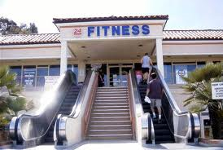
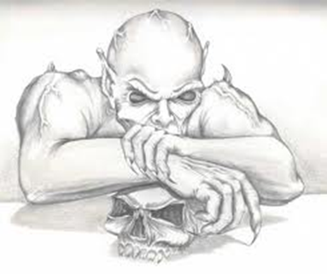
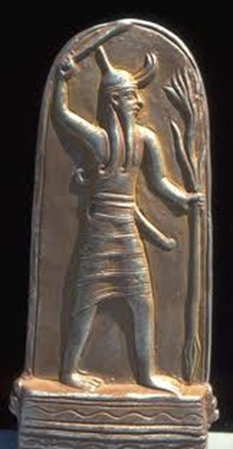
Other Mediums for Vocabulary
teenwitch.com
Notes:
Silhouette - silhouette
Irony – photo (fitness center)
Demoniac – sketch
Photo of sculpture – Baal
Art extension – have students make visuals of vocabulary words and “teach” words to class

Slide 28
During Reading
Help students form picture of ideas presented in text
Engages students
Notes:
Sketches require a close reading of the text to draw out details and progress to a more involved project – creation of a comic strip about the novel. Both activities may help draw students back into the text.

Slide 29
During Reading
Sketches
Characters (“photo album”; character trading cards)
Setting
Action/events
Life before
Life during
Life after
Cartography
Ad for showing theme/character/setting in novel
Notes:
Sketches require a close reading of the text to draw out details and progress to a more involved project – creation of a comic strip about the novel. Both activities may help draw students back into the text.
Note – sketching a setting is something my creative writing students found helpful in producing works of fiction.

Slide 30
It’s Your Turn!
Read the following passage.
Create a sketch showing your understanding of the details.
Share.

Slide 31
“The two cart-horses, Boxer and Clover, came in together, walking very slowly and setting down their vast hairy hoofs with great care lest there should be some small animal concealed in the straw. Clover was a stout motherly mare approaching middle life, who had never quite got her figure back after her fourth foal. Boxer was an enormous beast, nearly eighteen hands high, and as strong as any two ordinary horses put together. A white stripe down his nose gave him a somewhat stupid appearance, and in fact he was not of first-rate intelligence, but he was universally respected for his steadiness of character and tremendous powers of work.” (Orwell, 1945, p. 1)
Notes:
If possible, students could highlight the text that describes the characters.

Slide 32
- Body Map
Read the passage.
Sketch a body of a character.
Identify how the character behaves.
Share.
Notes:
Shows traits rather than physical details.

Slide 34
“My school days ran along very pleasantly. I stood well in my studies, not always so well with regard to my behavior. I was never guilty of any serious misconduct, but my love of fun sometimes got me into trouble. I remember, however, that my sense of humor was so sly that most of the trouble usually fell on the head of the other fellow. My ability to play on the piano at school exercises was looked upon as little short of marvelous in a boy of my age. I was not chummy with many of my mates, but, on the whole, was about as popular as it is good for a boy to be.” (Johnson, 1912, 2)
Notes:
What would be put for his brain?
Hands?
Heart?

Slide 35
After Reading
Reinforces content, concepts, and implications of text
Notes:
Show collage.

Slide 36
After Reading
Cartoons
Comics
Masks
Movie Poster
Collage
Thematic topic: injustice
Conceptualizing an abstract concept
Reflection sheet
Poem
Sculpture
Notes:
Any of these activities could be done at any point during or after reading. When done after reading, they serve as reinforcement of content.
Cartoons – political cartoon of the Russian Revolution, Holocaust, slavery, or equality
Comics – retelling the plot or the plot of a chapter
Masks – depictions of personalities of characters in novels
Character trading cards – details about key characters
Movie poster – what picture and key words would best capture the novel?
Directions for cartoons, comics, masks, trading cards and posters can be found online. None require special material.
Show collage.

Slide 37
Collage - Visual Art
Provides alternative to sketching
Anitra Redlefsen
..\Anitra Redlefsen.avi
Notes:
Show Anitra’s video
The assignment for the collage was to depict the theme of social justice in Anthem.

Slide 39
Notes:
This photo shows ownership of project and materials Students helped the artist’s husband pick up paper that had fallen to the floor.

Slide 40
Notes:
Students were thrilled to have a break from essays and tests!

Slide 41
Notes:
This collage shows the student’s impression of Night.

Slide 42
Notes:
This collage shows the student’s impression from Night.

Slide 43
War at Night
I stand there in the night in fear.
All I see is blood all over the ground.
I stand there watching and waiting
in my tears.
One guy down. Yes, he is down!
But that was one of my greatest fears.
It’s just the two of us now against the two of them.
We are fighting here at night,
With no daylight and no bright light.
Just the sound of twigs and branches in the
moonlight.
Notes:
After collage, artist had students write a reflection and a short poem. This poem written by a freshman after reading All Quiet on the Western Front.
Observe the role of imagery in the poem and the descriptive words. I feel the art helped the student visualize her poem more and helped her produce the rich descriptions.

Slide 44
Results of Collage
Extension of theme of novel
Explicit thought about conceptualizing theme
Increased student engagement
Additional purpose for reading
Discussion about art and its connection to novel
Alternative expression of thoughts about novel
Pride in work
Notes:
100% student participation!
My high school is about 80+% free or reduced lunch with 85% minority.
Teachers voted on all collages. Winner was awarded gift certificate and work framed and hanged in principal’s office.

Slide 45
Sculpture - Visual Art
Focuses on prevalent theme of novel
Provides alternative to sketching
Notes:
Sculpture – Memorial to people killed in Russian Revolution, Jewish victims of the Germans, or those enslaved in the United States.

Slide 46
It’s Your Turn!
Select a novel you have read.
Create a memorial to a character or group of characters in the novel OR create a collage to show a theme or other aspect of a novel.
Share with people at your table.

Slide 47
Arts Integration Checklist
Are meaningful connections made?
Is in-depth learning promoted?
Are high quality examples from the art and novel used?
Are the artistic processes of creating and responding incorporated into the lesson?
Is there a final evaluation?
(Authentic Connections:
Interdisciplinary Work in the Arts)

Slide 48
“Meaningful change in education will only come about through close examination and thoughtful reflection of current classroom practices that are dominated by written language. If public education is truly committed to having no child left behind, it would do well to consider bringing the arts along, too.” Lynch, 2007

Slide 49
Online Resources
National Endowment to the Arts (https://www.arts.gov/publications)
“The Qualities of Quality: Understanding Excellence in Arts Education”
(http://www.wallacefoundation.org/knowledge-center/Documents/Understanding-Excellence-in-Arts-Education.pdf)
Interdisciplinary Arts Education: Building Bridges to Connect Disciplines and Culture (http://www.eric.ed.gov/ERICWebPortal/custom/portlets/recordDetails/detailmini.jsp?_nfpb=true&_&ERICExtSearch_SearchValue_0=ED488767&ERICExtSearch_SearchType_0=no&accno=ED488767)
List of PDF publications of the Arts Education Partnership (http://www.aep-arts.org/additional-resources/)

Slide 50
Thank you!
Questions?
DBGFeldman@gmail.com

