Slide 1
@ the MALL - A guide to successfully integrating mobile devices
ETAI Northern Regional Conference – 23.8.2016
Jane Cohen englishwithjane@gmail.com
Twitter: #JaneCohenEFL
Blog: Route CPD for ELT
Notes:
@ the MALL - A guide to successfully integrating mobile devices
Our role as English teachers is to assist each of our students to learn English to the best of their ability. Mobile Assisted Language Learning (MALL) enables teachers to utilize students' hand-held devices, to engage and empower all learners, to achieve English language success. It is easier than you think!

Slide 2
Integrating mobile devices into the classroom:

Slide 3
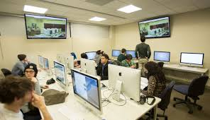
www.coloradotech.edu/Infographics/Tools-For-School
Notes:
“No more gizmos in my class!”
From a historical perspective technology has always had a place in education and always will.
The education system can be slow to adopt but ultimately the technolgogy makes it’s way into the classroom as technology used well can improve learnig outcomes.
Here you can see the move from CALL (computer assisted language learning) which is so expensive to MALL (mobile assisted language learning) which is more accessible, cheaper and has less technolgocial problems.

Slide 4
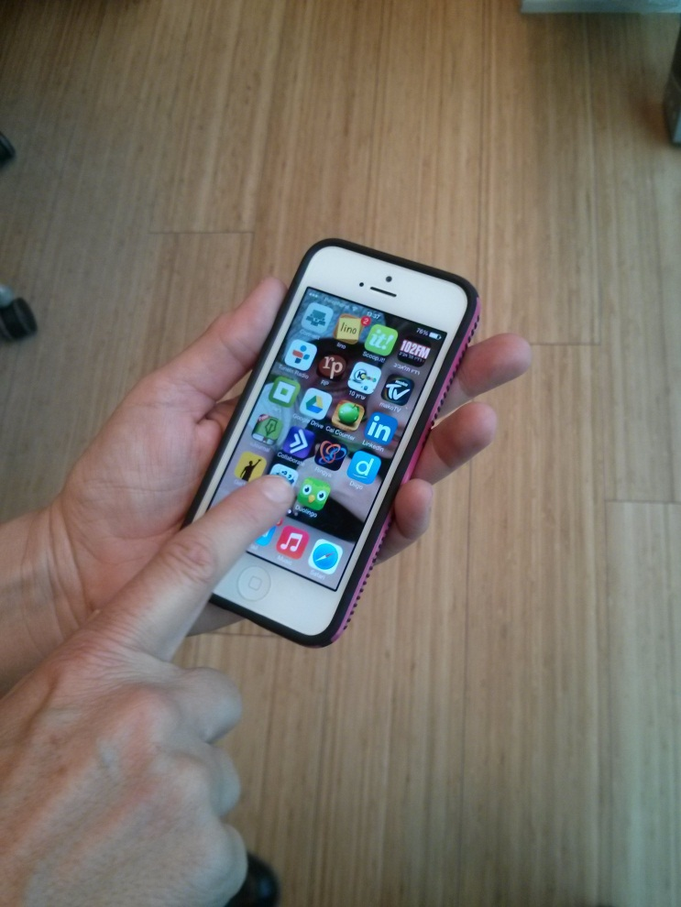
Notes:
My Iphone is like my second brain, it is my watch, my calendar, my address book, my maps, my gps, my journal, it is my connection to my family and friends, through facebook, viber, whatsapp, messenger, my personal trainer through nike running and runkeeper, my camera and audio and video recorder, my tv, (channels, my mail, my music playlists etc, It is also a place for assessing all of my teaching resources through google drive, quizlet, Kahoot. I too can practice my Spanish with Duolingo. I can check my bank account and make medical appointments, check a train timetable and park with Pango.
It is also a great source of professional development through twitter, Linkedin, take an online course with coursera, adobe connect (virtual classroom) and update my own blog through the edublogs app.
My Iphone is an extension of me. It goes everywhere with me. I would be completely lost without it, and so would our students.
That is why I believe that it makes sense to integrate mobiles into the classroom, because just as I love it so do my students. By using it pedagogically I can achieve so much more than by simply banning the gizmos and focusing on the textbook (which by the way I love too)

Slide 5
Mobile learning refers to:
Learning that takes place when the learners are mobile
Learning that takes place when the devices are mobile
Learning that takes place when the learning is mobile

Slide 6
Moblie learning in the classroom
“….technologies, mobile or otherwise, can be instrumental in language instruction. Ultimately, though, they are not in and of themselves instructors; rather, they are instructional tools. And the effective use of any tool in language learning requires the thoughtful application of second language pedagogy.”
George M. Chinnery University of Maryland Baltimore County
https://youtu.be/H2Ly1FOHIa4

Slide 8
Mobile Assisted Language Learning is:
Personal
The world is your classroom
Interactive,
Accessible &
Experiential
Interesting, Engaging & Meaningful
Learning anywhere anytime
Notes:
BYOD
Ss come to the class with their personal devices which in itself is motivating
The use of the device enables ss to be active in the classroom and at home.
Learning is authentic and relevant to the ss world and can be used to develop ss’ higher order thinking skills (promotes creativity)
Great for providing access to ss with learning difficulties (I’ll give you some examples shortly)
Enables blended learning environment that encourages collaboration and cooperation through the gathering of information, use of google docs, recording and photographing, videoing and sharing

Slide 9
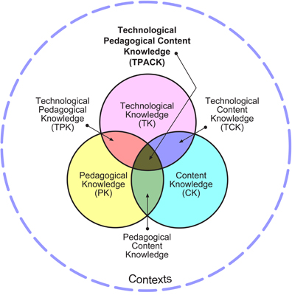
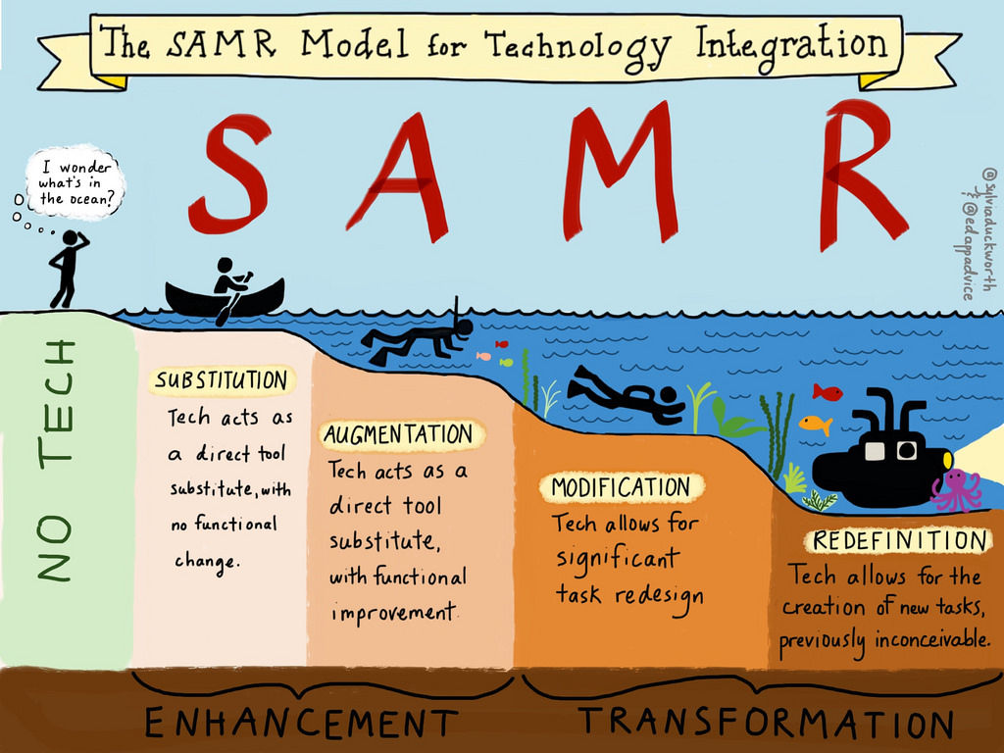
"If we teach today as we taught yesterday, then we rob our children of tomorrow." John Dewey

Slide 10
http://www.schrockguide.net/samr.html

Slide 11
This tool can be used for:
Brainstorming, polls/surveys, short answer questions and more...
answergarden.ch/325727

Slide 12
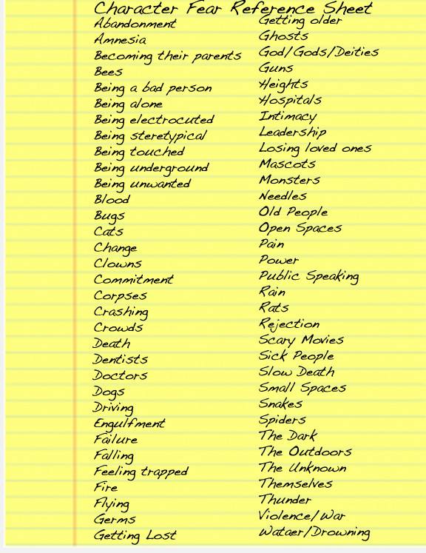
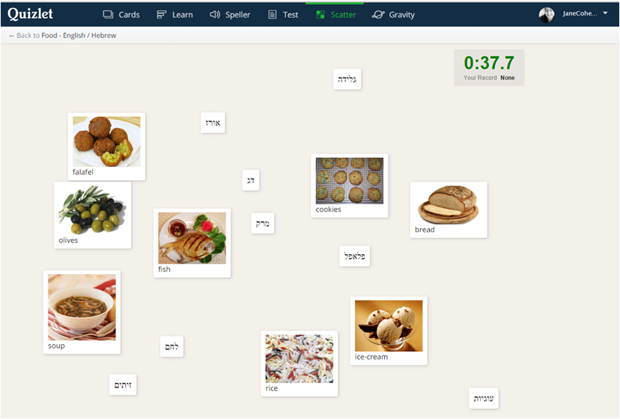
Quizlet

Slide 13
What do you think this is a commercial for?
https://youtu.be/WDd5tJ-VCEo

Slide 14
Hypnosis - Keywords
quizlet.com/_23qelv

Slide 15
Complete the GoogleDoc writing task for homework
https://goo.gl/fkzHzg
Notes:
Show the homework task

Slide 16
Kahoot!
https://getkahoot.com/ways-to-play

Slide 17
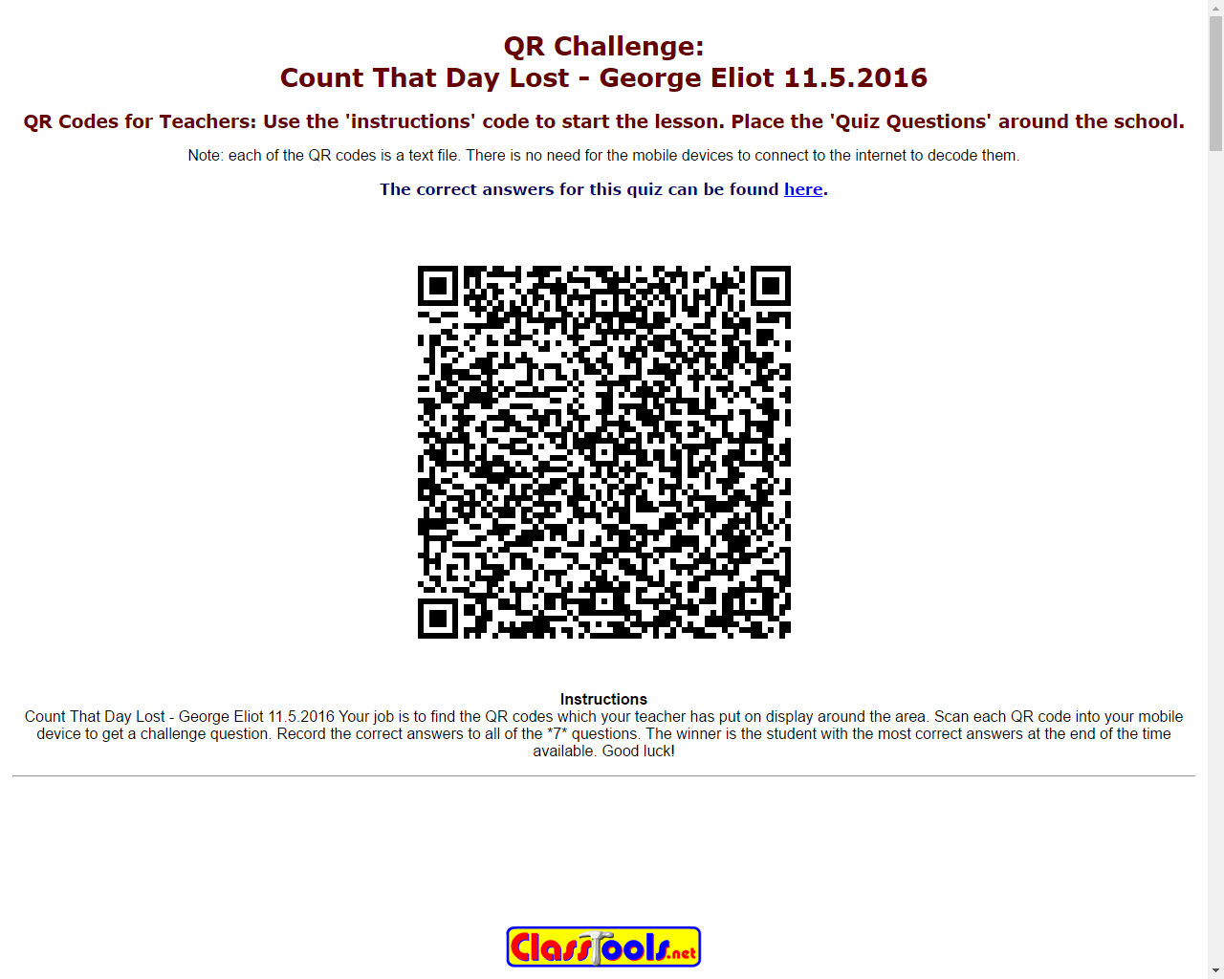
QR Codes
https://youtu.be/cZGghmwUcbQ

Slide 18
Random Acts of Kindness

Slide 19
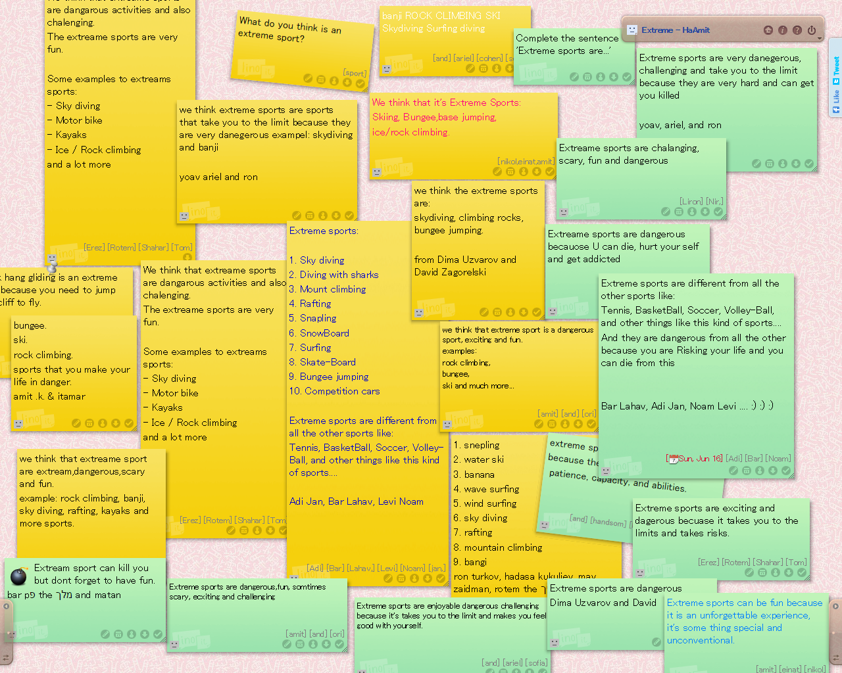
Linoit
Linoit
Linoit.com

Slide 20
Assistive Technology (AT)
“Any device, equipment, or service that improves the learning and capabilities of students with disabilities.”
Alison Maria Lawrence, Meeting Special Needs in the Classroom, slide share
Graphic organizers and outlining
Word processing programs
Text to Speech
Adobe Reader
Audio books
Speech-recognition software
Smartphones for recording

Slide 21
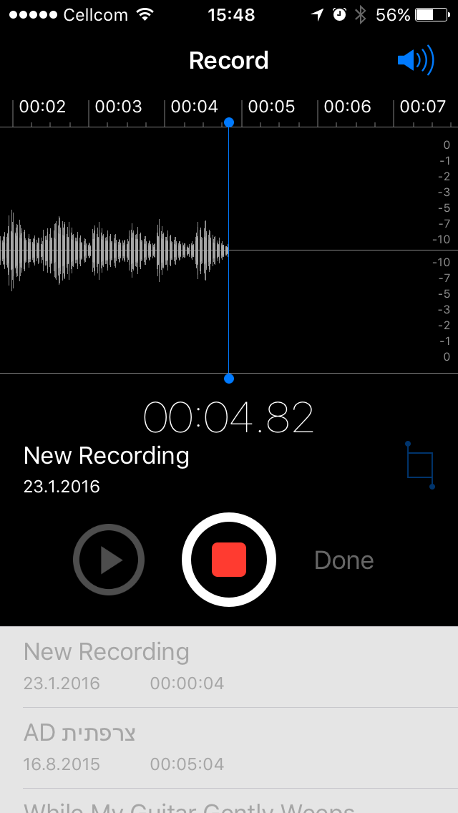
Encourage your students to use their Smartphones to record you reading the text

Slide 22
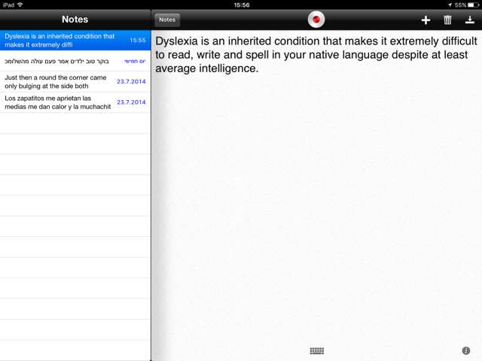
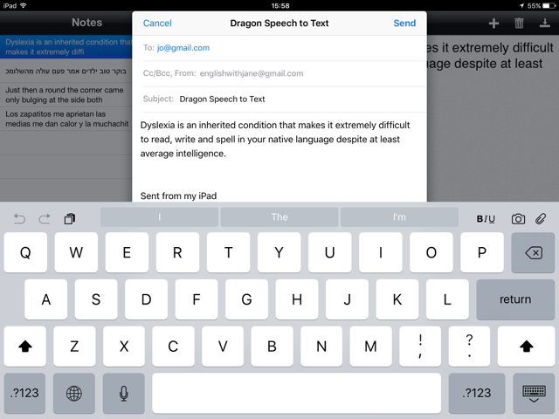
Ask your students to record their thoughts on their Apple & Android devices with the Speech to Text application: Dragon Dictate
Student records their thoughts
Student e-mails text to teacher

Slide 23
Save texts as PDFs, and then use the Adobe PDF ‘Read out loud’ feature, to enable students to listen and read simultaneously
Click on view
Click on ‘Read out loud’
Click on ‘Read to end of the document

Slide 24
For book reports allow students to listen to Audiobooks
Photo: en.wikipedia.org

Slide 25
“There is no doubt that technology has changed the lives of those who struggle to read and write, and that educators should embrace the changes.”
Kyle Redford, MindShift

Slide 26
Some simple MALL activities for getting started:
Show a picture from your photo album to a partner, and answer their questions - write a summary of what your partner told you
Ask students to take a photo of that they are doing at 3 specific times – Sunday at 15:00, 19:00 and at 21:00 Next lesson in pairs students use the past progressive to discuss what they were doing on Sunday at each time.
Summarise a text in a tweet
Create micro stories – www.sixwordmemoirs.com
As a pre-reading task create a wordle and ask students questions based on the word cloud – What do you think the text is about?

Slide 27
When integrating Mobile devices we need to ask ourselves a few questions:
Am I increasing my students’ motivation and engagement?
Am I allowing them to practise and produce language in useful ways in class?
Am I giving them the opportunity to take their language learning out of the classroom and have extra exposure to English?
In short:
Why am I doing this activity with mobile devices?
What learning benefit will this activity bring?
Hockly, N. Dudeney, G. Going Mobile (2014)

Slide 28
@ the MALL Checklist:
Set classroom rules for mobile use – create them together in answer to the question “What can we do with our mobile devices in class?”
Think about wifi availability and whether the suggested apps are available for both IOS and Android
Decide how content is going to be shared & stored– dropbox, google drive, a wiki or blog, e-mail or via a Facebook closed group or Edmodo
Set a clear time limit for completing a task to avoid distraction
Ensure the task enhances the learning experience
Utilise your students knowledge and expertise – ask for help
Always write clear instructions, and then model the task

Slide 29
Bibliography
http://estydster.blogspot.co.il/2009/01/blog-post_24.html
http://amisalant.com/?p=1167
http://i-gordon.blogspot.co.il/2014/08/samr-model.html
https://www.youtube.com/watch?v=Fh-FRl3iWG4
https://www.youtube.com/watch?v=H2Ly1FOHIa4
Chinnery G. M Language Learning & Technology January, 2006, Volume 10, Number 1 pp. 9-16 http://llt.msu.edu/vol10num1/emerging/
Handbook of Technological Pedagogical Content Knowledge (TPCK) for Educators, 2008, New York: Routledge
Hockly, N. Dudeney, G. (2014) Surrey, Going Mobile, Teaching with hand-held devices, Delta Publishing
Pegrum, M., Mobile Learning: Languages, Literacies and Cultures, Mamillan 2014
Kukukska-Hulme A, Norris L, Donohue J, Mobile pedagogy for English language teaching: a guide for teachers Teaching English, ELT Research Papers 14,07

Slide 30
Thank you for your participation.
This workshop will be published on my blog:
Route CPD for ELT
Follow me:
Twitter: @JaneCohenEFL
LinkedIn: JaneCohenEFL

